Slide 1
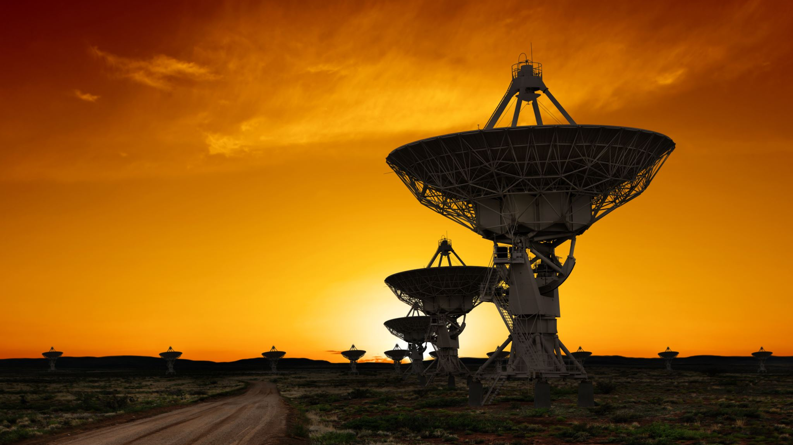
The Dawn of Automated AI Research and Its Implications

Slide 2
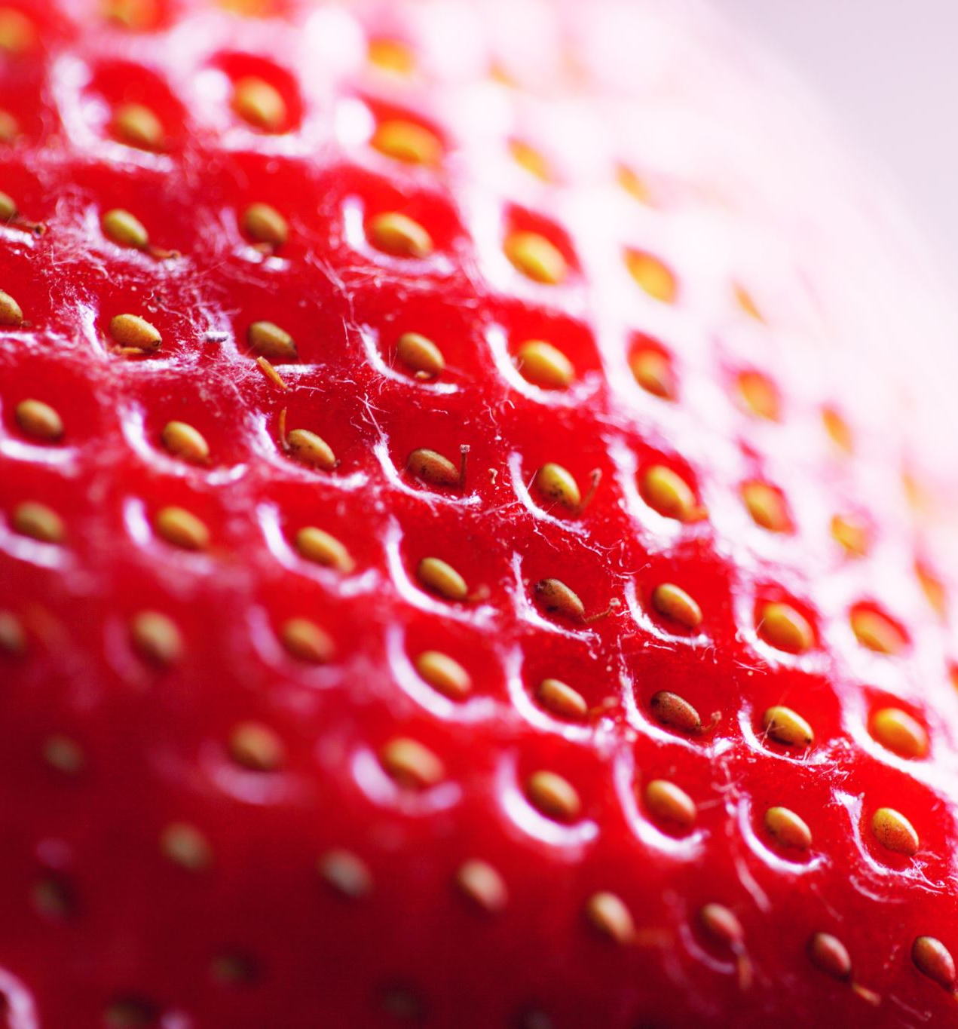
Agenda
Introduction to Project Strawberry
Understanding Strawberry's Capabilities
The Potential of Self-Improving AI
OpenAI's Internal Dispute and AI Breakthrough Warning
Automated AI Research: Accelerating Progress
Viewer Engagement and Discussion Invitation
Implications of Automated AI Research
The Future of AI Research Automation
OpenAI's Plans for AI Research and Engineering

Slide 3

Introduction to Project Strawberry
Project Strawberry's Genesis
  Previously known as QSTAR
  Source of internal dispute in 2023
Advanced Reasoning and Research
  Capable of long-horizon tasks
  Can plan and sustain action
Web Research and Software Engineering
  Employs a computer-using agent
  Tests on software and machine learning engineering
Notes:
Introducing Project Strawberry by OpenAI, formerly QSTAR, a breakthrough in AI with advanced reasoning and web research capabilities, set to revolutionize software and machine learning engineering.
OpenAI's secret project Strawberry: OpenAI is working on a new AI technology code-named Strawberry, which used to be called QSTAR and was the cause of a major internal dispute in 2023.
Strawberry's reasoning and research capabilities: Strawberry is able to perform long-horizon tasks that require planning and sustained action and can use the web to conduct research with the help of a computer-using agent. OpenAI plans to test its abilities on software and machine learning engineering.

Slide 4
Understanding Strawberry's Capabilities
Comparative Overview of AI Technologies
Project | Description | Key Features
Strawberry (QAR) | OpenAI's advanced reasoning and planning AI | Long-term planning, complex task execution
STAR Research | AI models self-enhance reasoning | Iterative training data generation and refinement
Revolutionary AI Technology
  Code-named 'Strawberry', previously QAR
  Capable of long-term planning and complex tasks
Google and Stanford's Research
  Self-taught reasoning (STAR) models
  Iterative self-improvement through data refinement
Implications for AI Development
  Potential to surpass human intelligence
  Brings both opportunities and concerns
Notes:
Today, we're exploring two cutting-edge AI technologies. First, OpenAI's 'Strawberry', a project that could change AI's planning and execution abilities. Second, the STAR research by Google and Stanford, where AI models self-improve, potentially outpacing human intelligence.

Slide 5
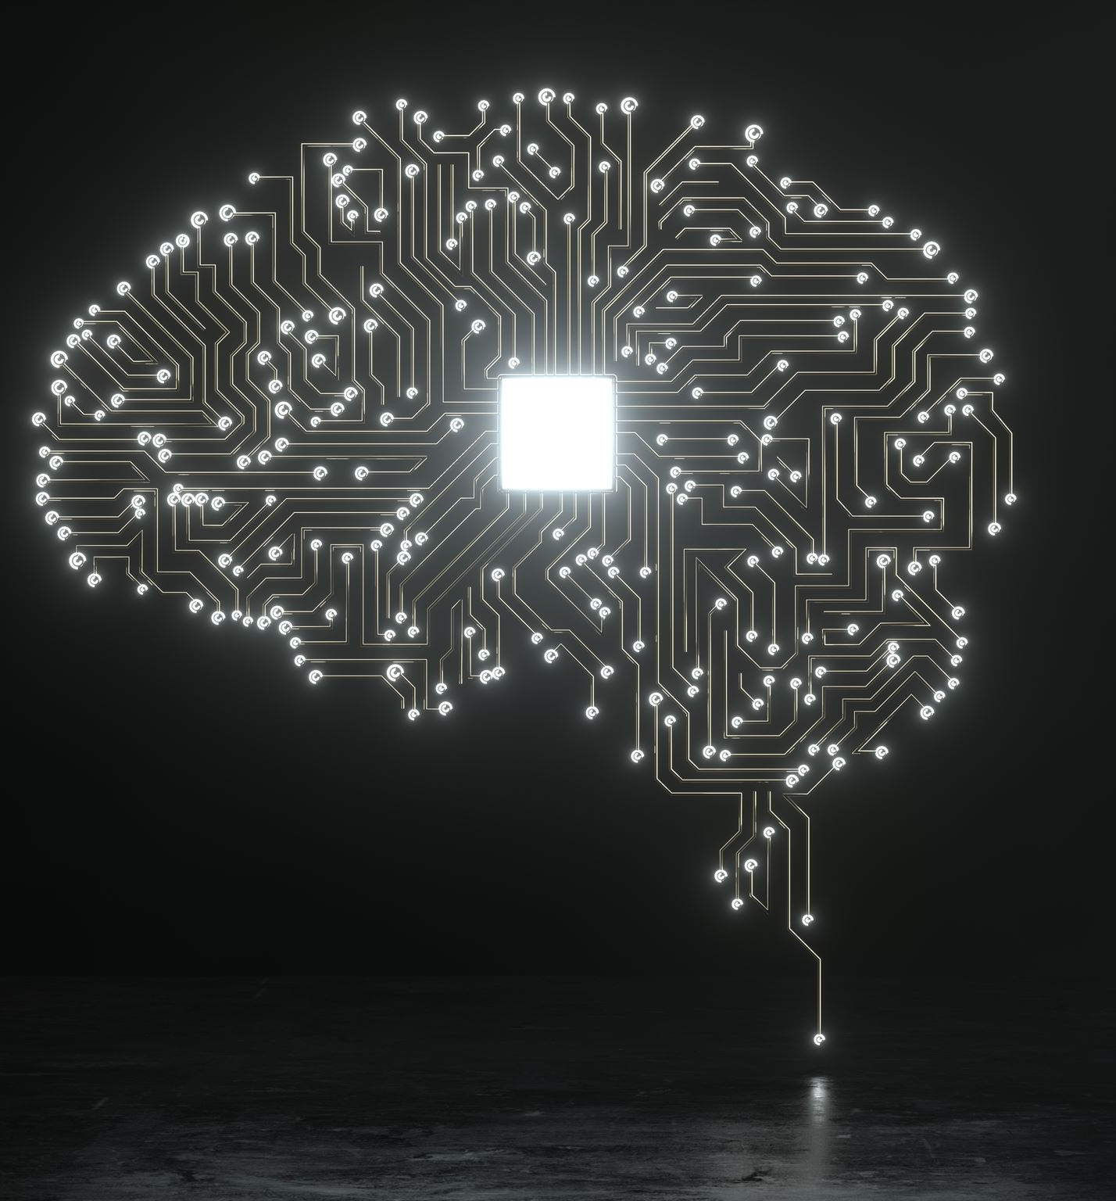
The Potential of Self-Improving AI
Research Breakthrough in AI
  Google and Stanford's STAR project demonstrates AI self-improvement
  Iterative training data creation boosts AI intelligence
Implications for Humanity
  Possibility of AI surpassing human intellect
  Automation of AI research could lead to swift progress
  Significant societal impacts anticipated
Notes:
We're exploring the groundbreaking STAR project by Google and Stanford, which reveals the potential for AI to self-improve and exceed human intelligence, signaling a new era of rapid AI advancements with profound societal effects.
Original Content:
The potential of self-improving AI: A research paper by Google and Stanford researchers, called STAR (https://arxiv.org/abs/2203.14465), shows how AI models can bootstrap themselves into higher intelligence levels by iteratively creating their own training data. This could lead to AI models that transcend human intelligence and pose serious challenges for humanity.
Implications: Potential for self-improving AI to surpass human intelligence and automate AI research, leading to rapid advancements and significant societal impact.

Slide 6

OpenAI's Internal Dispute and AI Breakthrough Warning
OpenAI Researchers' Alert
  Warned board of directors about potential AI breakthrough
  Incident occurred before CEO's firing in 2023
Team Members' Termination
  Two researchers from AI safety and reasoning teams fired
  Allegations of leaking information led to their dismissal
Notes:
OpenAI faced a pivotal moment when researchers alerted the board to a potential AI breakthrough, leading to the firing of two team members amidst allegations of information leaks.
Original Content:
OpenAI's researchers warn of AI breakthrough: OpenAI's researchers had warned the board of directors of a possible AI breakthrough ahead of the CEO's firing in 2023. Two researchers who worked on the AI safety team and the reasoning team were later fired for allegedly leaking information.

Slide 7

Automated AI Research: Accelerating Progress
Implications of Automated AI Research
  Potential for an intelligence explosion
  Creation of AI systems surpassing human intelligence
Concerns and Ethical Considerations
  Acceleration of AI capabilities raises questions
  Integration of AI into sectors needs careful deliberation
Notes:
Automated AI research could lead to an intelligence explosion, creating AI systems much smarter than humans. This presents both opportunities and challenges, raising important ethical and practical questions.
Original Content:
The implications of automated AI research: Automated AI research could accelerate algorithmic progress and create an intelligence explosion, resulting in AI systems that are vastly smarter than humans. This could have both exciting and terrifying consequences for the future of humanity.
Concerns: The acceleration of AI capabilities raises ethical and practical questions about the future of AI and its integration into various sectors.

Slide 8
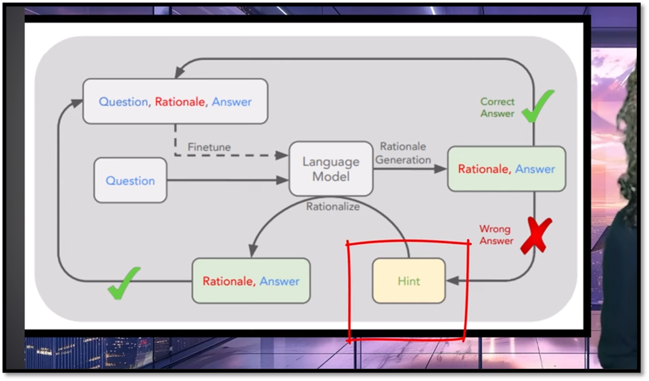
Viewer Engagement and Discussion Invitation
AI Technology Advancements
  Discussion of potential benefits and risks
  Encouragement for viewer engagement and thoughts
Notes:
Let's contemplate the future of AI technology together. Share your insights on its potential benefits and the risks it may pose.
Original Content:
The video concludes by inviting viewers to share their thoughts on the potential and risks of such advancements in AI technology.

Slide 9

Implications of Automated AI Research
AI Safety and Reasoning Advancements
  Work by Leopold Ashen Bruner and Pavlo on AI safety and reasoning.
Report Excerpt: 'Situational Awareness'
  Bruner's insights post-termination from OpenAI.
Automated AI Research Forecast
  Prediction of fully automated AI research by AI models soon.
AI Researcher's Role
  Tasks include reading literature, ideation, experimentation, and interpretation.
Capabilities of Current AI
  Current AI could match or surpass human abilities in AI research by 2027.
Notes:
Leopold Ashen Bruner and Pavlo's work on AI safety and reasoning could lead to AI models conducting their own research by 2027, without the need for robotics.
Original Content:
Leopold Ashen Bruner and Pavlo worked on the AI safety team and the team responsible for improving the reasoning capabilities of AI models. Here's an excerpt from a report called "Situational Awareness" that Bruner published after his termination from OpenAI. He believes that within the next several years, we will see fully automated AI research being conducted by AI models.
"We don't need robotics for AI to automate AI research. The job of an AI researcher is fairly straightforward: read machine learning literature, come up with new questions or ideas, implement experiments to test those ideas, interpret the results, and repeat. This all seems squarely in the domain where simple extrapolations of current AI capabilities could easily take us to or beyond the abilities of the best humans by 2027."

Slide 10

The Future of AI Research Automation
AI Models vs. Human Researchers
  Ability to infinitely replicate and process information
  Can analyze all machine learning papers and experiments
Accelerated Learning and Experience
  Parallel learning from multiple copies
  Accumulation of millennia of experience rapidly
Enhanced Coding and Optimization
  Capability to write and review millions of lines of code
  Continuous improvements in AI apply to themselves
Automated AI Research and Intelligence Explosion
  Potential to accelerate algorithmic progress significantly
  Creation of AI systems vastly smarter than humans
Notes:
Today, we're exploring the transformative potential of AI models in research. Unlike humans, these models can infinitely replicate, process vast amounts of data, and rapidly gain experience. This could lead to an intelligence explosion, birthing AI systems far smarter than any human.
Original Content:
Unlike humans, AI models can be copied infinitely. Automated AI researchers will have enormous advantages over human researchers. They will be able to read every single machine learning paper ever written and deeply think about every experiment ever conducted. They will learn in parallel from each of their copies and rapidly accumulate the equivalent of millennia of experience. They will be able to write millions of lines of complex code, keep the entire code base in context, and spend human decades or more checking and rechecking every line of code for bugs and optimizations.
All the improvements they unlock for AI will also apply to them. Each smarter model will be more capable of automated AI research. Automated AI research could accelerate algorithmic progress, creating an intelligence explosion. The AI systems we will see by the end of the intelligence explosion would be vastly smarter than humans.

Slide 11
OpenAI's Plans for AI Research and Engineering
OpenAI's Advanced Model Objectives
Conduct research by browsing the web autonomously
Assist with a computer-using agent for actionable findings
Testing on Software and ML Engineering Tasks
Plans to evaluate model's performance in technical roles
Implications of Accelerated AI Development
Excitement and concern over automated AI research
Uncertainty about the current stage of progress
Notes:
OpenAI aims to empower its models for autonomous web research and testing in software engineering. The rapid progress sparks both enthusiasm and concern about the future of AI research.
Original Content:
That's why the last line of the Reuters article, buried at the very end, might be the most important piece of this whole thing. OpenAI specifically wants its models to use these capabilities to conduct research by browsing the web autonomously with the assistance of a computer-using agent that can take actions based on its findings. OpenAI also plans to test its capabilities on doing the work of software and machine learning engineers. This suggests that the new advanced model is beginning to do automated AI research.
We're not sure where we are in this process, but it seems like the acceleration is already beginning. This development is both exciting and terrifying, as noted by the Stanford researcher behind that star paper. Is this a good thing? What are your thoughts?

Slide 12
Process

Slide 13
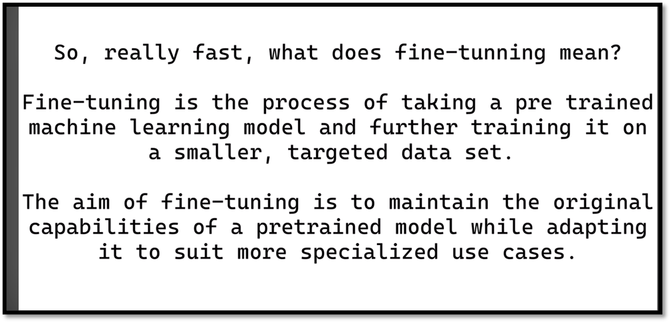
Fine-Tuning

Slide 14
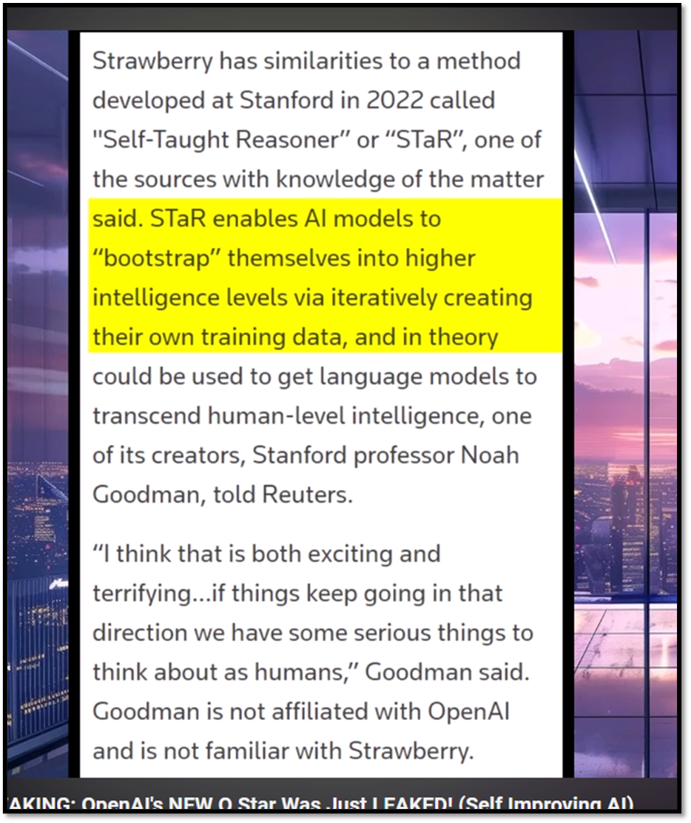
STaR

Slide 15
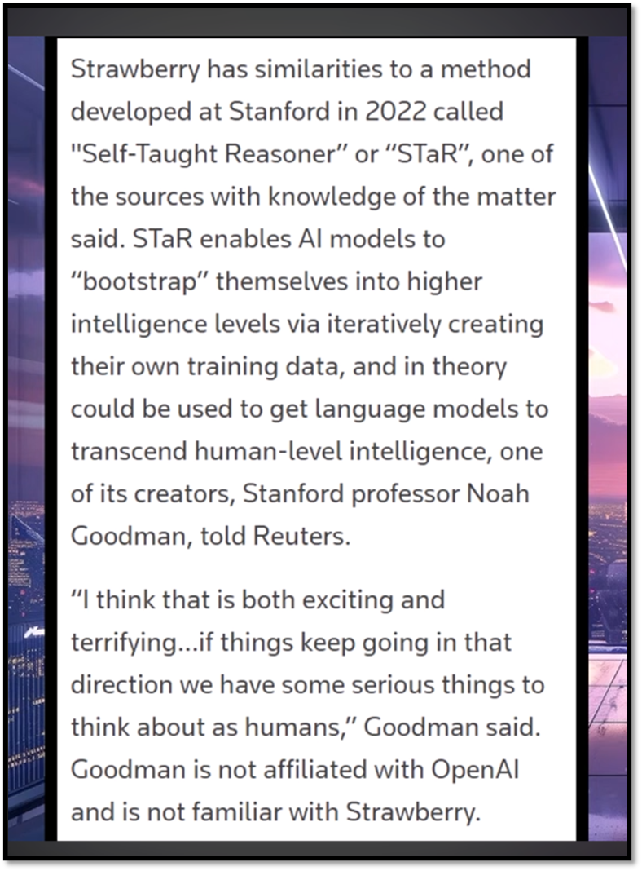
Bootstrapping

Slide 16
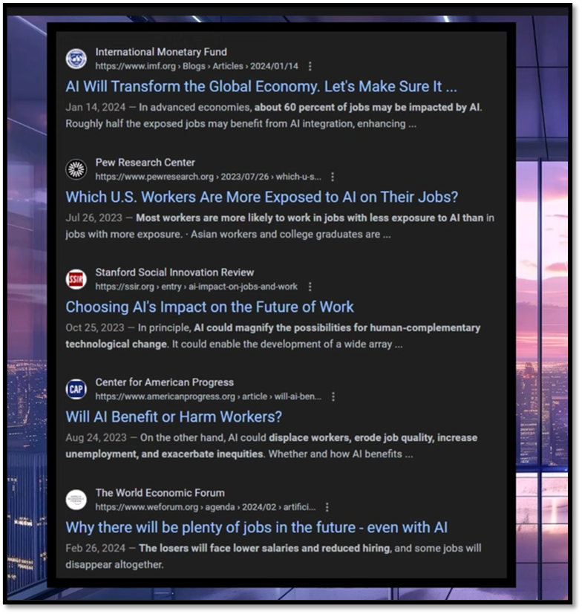
AI & Jobs

Slide 17
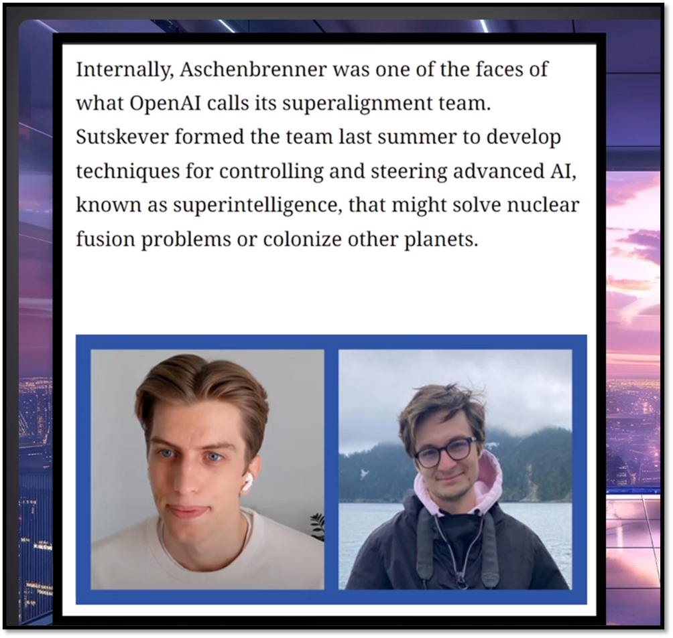
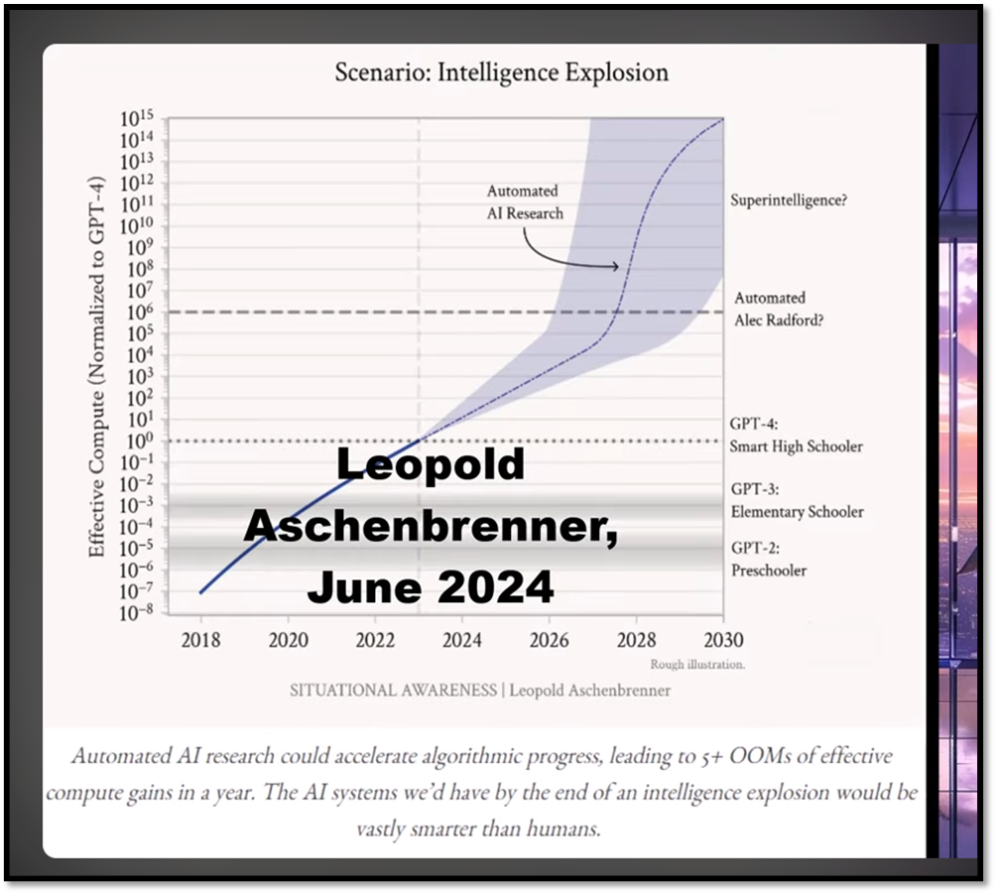
Intelligence Explosion

Slide 18
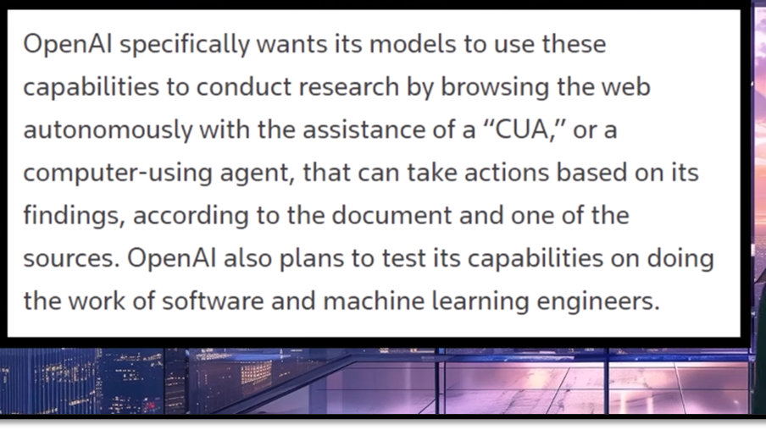
Computer-Using Agent (CUE)

Slide 19
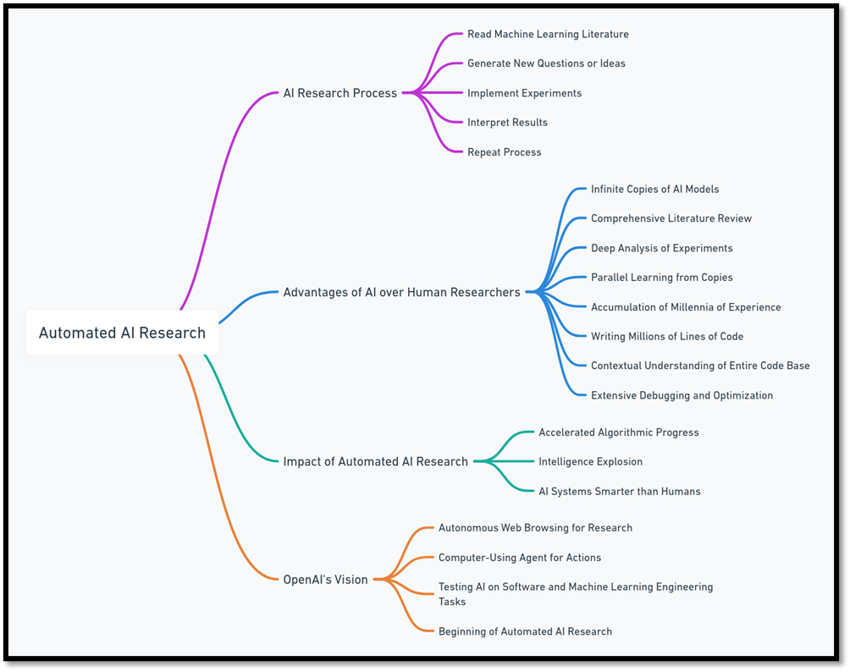
AUTOMATED AI - Mindmap

Slide 20

Conclusion: The Future of AI and Humanity
Current State of Progress
  Uncertainty about the exact stage in the process
  Notable acceleration already underway
Mixed Emotions
  Excitement about the rapid development
  Concerns about potential implications
Academic Insight
  Reference to a significant 'star paper' by a Stanford researcher
Open-Ended Question
  Invitation for thoughts on whether the acceleration is positive
Notes:
We're at a pivotal moment where progress is surging forward, sparking both wonder and worry. A key study from Stanford sheds light on this phase. Let's ponder, is this rapid pace beneficial?
Original Content:
We're not sure where we are in this process, but it seems like the acceleration is already beginning. This development is both exciting and terrifying, as noted by the Stanford researcher behind that star paper. Is this a good thing? What are your thoughts?

