Slide 1

SITUATIONAL Awareness
The Decade Ahead
Note. This PowerPoint was created by Dr. Lance with the use of Copilot in hopes to draw attention and raise awareness to:
Situational Awareness: The Decade Ahead by Aschenbrenner, L. (2024).

Slide 2
Agenda
Overview
The Evolution of AI - From GPT-4 to AGI
Transition to Superintelligence
The Industrial and Security Challenges
Racing to the Trillion-Dollar Cluster
Lock Down the Labs
Superalignment - The Critical Challenge
Global Implications and the AI Race
Government Involvement in AGI Development
Reflections and Future Considerations

Slide 3
The Evolution of AI - From GPT-4 to AGI
Historical Progress
Progression from GPT-2 to GPT-4
GPT-4 exhibits reasoning abilities comparable to a high school graduate
Orders of Magnitude (OOMs)
Quantifies AI advancements in terms of OOMs
Prediction: AI systems will achieve capabilities akin to human researchers by 2027

Slide 4
Transition to Superintelligence
Beyond AGI
AI evolution will extend beyond AGI
Development of superintelligence with superior cognitive abilities
Acceleration
Potential for AI to self-improve
Research time could be compressed from decades to years or months
Impact
Superintelligence could alter global power dynamics
Profound economic and military consequences

Slide 5

The Industrial and Security Challenges: Racing to the Trillion-Dollar Cluster
Industrial Mobilization
  AI race will drive massive industrial investment
  Trillions of dollars will be invested in GPU clusters and data centers
Energy Demands
  Significant increase in electricity production needed
  Potential increase by tens of percent to support AI infrastructure

Slide 6

The Industrial and Security Challenges: Lock Down the Labs
Critical oversight in AI security
  Major labs treating security as secondary
Risk of exploitation by state actors
  Notably the CCP

Slide 7

Superalignment - The Critical Challenge
Technical Problem
  Superalignment remains unsolved
  Ensuring smarter AI systems remain under control
  Risks associated with failure are immense
Tension
  Rapid pace of AI development
  Potential for alignment issues to spiral out of control
  Possible catastrophic outcomes
Insight
  Maintaining AI systems aligned with human values and goals
  Critical challenge of the upcoming decade

Slide 8
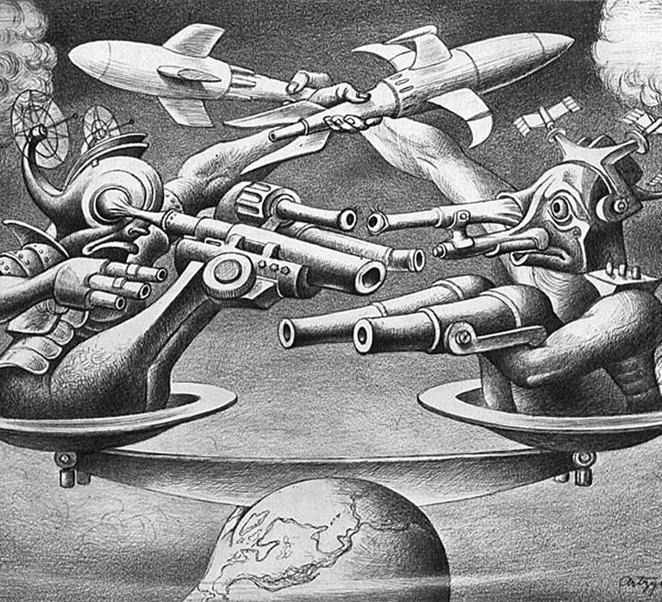
Global Implications and the AI Race
Strategic Importance
  Superintelligence provides a decisive advantage to nations
  Democratic nations must prevail in the AI race against authoritarian regimes like China
Existential Stakes
  Survival of democratic values and global stability depend on the AI race outcome
This Photo by Unknown Author is licensed under CC BY-SA-NC

Slide 9

Government Involvement in AGI Development
The Project
  By 2027, U.S. government predicted to lead AGI development
  Shift from private-sector dominance to state-led initiatives
Security and Secrecy
  Managing superintelligent AI requires secure, classified environments
  Potentially under government control
Critical Question
  Can a government-led initiative manage complexities and risks of superintelligent AI?

Slide 10

Reflections and Future Considerations
Unprecedented Era
  AI reaching and surpassing human intelligence
  Critical questions about humanity's future
Strategic Decisions
  Upcoming years pivotal for AI's impact
  Potential for beneficial or catastrophic outcomes
Reflection
  Contemplate consequences if predictions come true
  Emphasize weight of decisions in the next decade

