Slide 1

Responsible AI Use in Education: Principles and Practices
Guidelines for ethical and effective AI in learning
Notes:
Segment 1 — The AI Village (agents act toward goals)
Speaking notes:
“We’re seeing AI move beyond Q&A. In the AI Village project, multiple models were placed in a shared environment and given goals—plan events, sell merchandise, raise funds—and then left to pursue those goals while coordinating with others. Over 24 weeks and across 12 models, a pattern emerged: some models were stronger at task execution and coordination (think: getting things done), while others excelled in human-facing communication—richer vocabulary, more positive tone, more formal language.
SHOW THE AI VILLAGE WEBSITE AND ARTICLE.
The AI Village in Numbers — LessWrong
AI Village
In the AI Village, Anthropic models tend to excel at getting stuff done, while OpenAI models stand out by maxing out measures of linguistic style. Interestingly, this is in line with recent findings by Anthropic and OpenAI themselves reporting that Claudes are mostly used for coding and other agentic tasks, while GPTs are predominantly used as conversational partners. Meanwhile in the AI Village, we saw that Claude 3.7 Sonnet ran most of the fundraisers and Claude Opus 4 set up much of the real-life event and then went on to win both the merch store competition and the gaming competition. At the same time, we see OpenAI models excelling at every stylistic measure we explored: Most cheerful conversationalist? GPT-4o. Richest vocabulary? o3. Most formal? GPT-5.
Segment 2 — Physical AI (robots need hard-won data)
Speaking notes:
“Physical AI (robots in human spaces) needs real-world motion and sensor data—not just internet text. Scale has built what they call a Data Engine for Physical AI. Think of it as a system for gathering, labeling, and cleaning up the massive amounts of robotics data needed to train foundation models. It started with self-driving cars but is now rapidly expanding into robots of all kinds. They’ve already logged over 100,000 production hours at their lab in San Francisco and are supplying data to leading robotics companies.
“But here’s the core challenge—the Robotics Data Gap. Large language models like ChatGPT train on trillions of words from the internet. Image models train on billions of pictures. But robots? They can’t scrape the internet for physical experience. Every motion, every grasp, every navigation attempt has to be recorded in the real world, one demonstration at a time. Today, even the biggest open-source robotics datasets only have about 5,000 hours of interaction combined. That’s tiny. To get reliable foundation models for robotics, researchers will eventually need data on the scale of language and vision models. That gap is the biggest bottleneck holding robotics back.”
Scale emphasizes that the data has to be abundant, diverse, and enriched. Abundant means collecting interactions at scale, both from robots and from human demonstrations. Diverse means capturing all the variations of objects, environments, and situations robots will face—because they won’t just work in one lab, they’ll work in the messy real world. Enriched means the data isn’t just raw recordings; it’s carefully annotated with details about intent, steps taken, success, and failure. Just like we provide feedback on student assignments, robotics data has to be layered with feedback and validation so models actually learn from it.”
Key Points (Quick Reference)
Data = foundation of AI. Poor data = poor performance; in robotics, mistakes = safety risks.
Data Engine: collection + annotation + validation; scaled from cars → robots.
Robotics Data Gap: no internet-scale repository; only ~5,000 hours exist today; far too little.
Data must be:
Abundant (lots of examples, consistent volume)
Diverse (different objects, tasks, environments)
Enriched (annotated with intent, success/failure, structure).
Future impact: Reliable robots in workplaces and homes depend on solving the data challenge.

Slide 2
AI as a Tool: The Role of Human Supervision
AI as a Tool
AI enhances efficiency but cannot replace human judgment or responsibility in decision-making.
Limitations of AI
AI processes data quickly but lacks true understanding of context and truth.
Human Supervision Essential
Educators must guide and validate AI outputs to ensure accurate and contextual use.
Notes:
AI as a Tool: The Role of Human Supervision
Speaking Notes:
“When we think about AI in education, the first thing to remember is that it is a tool. It can help us move faster—drafting lesson plans, rewriting instructions, brainstorming ideas—but it cannot replace human judgment. A tool is valuable only when it’s guided by someone who understands the bigger picture. Just like a calculator won’t design the problem set for you, AI can’t know which goals matter for our students or what fits into our college’s policies and context.
AI’s biggest strength is processing information quickly. It can summarize a 30-page article in seconds. But speed does not equal understanding. AI does not actually know truth, meaning, or context—it predicts patterns based on data. That’s why an AI summary might leave out the key nuance of a policy or misrepresent something that’s crucial in a student’s life.
This is where human supervision becomes essential. As educators, we don’t just pass along information—we add meaning, context, and accountability. Our role is not to reject AI outright, but to stand at the intersection—letting it speed up certain tasks, while ensuring that the final output is true, safe, and contextually correct.”
Key Points:
AI is a tool for efficiency, not a replacement for professional judgment.
It lacks truth and context; outputs are predictions, not understanding.
Human supervision ensures accuracy, alignment with local context, and accountability.
Classroom examples: AI drafts → faculty/student validates with deadlines, policies, safety steps.

Slide 3
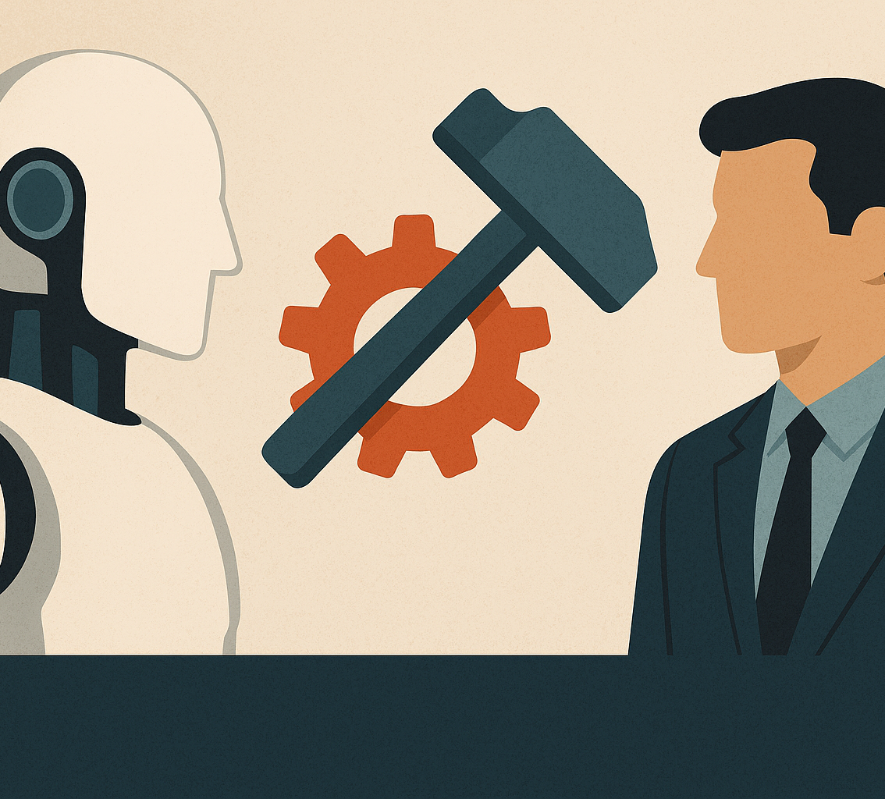
Evaluating Safe and Unsafe AI Content Generation
Safe AI Content Usage
  AI content generation is safer in controlled environments like creative writing or brainstorming support where errors have low impact.
Risks of Unchecked AI Content
  Allowing AI to generate unchecked content in sensitive areas like medical advice or legal documents can lead to serious harm.
Notes:
Evaluating Safe and Unsafe AI Content Generation
Speaking Notes:
“Not all uses of AI carry the same level of risk. One of the most practical conversations we can have with students is around safe versus unsafe use.
Safe uses are low-stakes, creative tasks. Think of brainstorming essay topics, generating practice quiz questions, or rephrasing text into simpler English for ESL students. If AI makes a mistake here, the harm is small—it’s easy to spot, and the student still has to shape the final work. This kind of use supports learning rather than replacing it.
But there are also unsafe or high-stakes uses. These are areas where unchecked AI content can cause real harm. Examples include letting AI give medical advice, draft legal documents, or make grading decisions. In these cases, the risk isn’t just that AI could be wrong—it’s that someone could act on that mistake without realizing it. A student who submits AI-written lab results without ever doing the experiment hasn’t learned the process and might also create a dangerous misunderstanding in the lab.
As faculty, we can help by drawing these lines clearly. In our syllabi and assignments, we should name the tasks where AI support is appropriate, and where it is absolutely not. This makes expectations transparent and gives students confidence in how to use AI responsibly. If they know where it’s safe, they’re less likely to experiment recklessly in unsafe areas.”
Key Points:
Safe: creative, brainstorming, tutoring, ESL support (low stakes).
Unsafe: medical, legal, grading, lab results, compliance tasks (high stakes).
Faculty role: clearly define safe vs. unsafe in syllabi and assignments.
Goal: give students confidence and prevent reckless misuse.

Slide 4
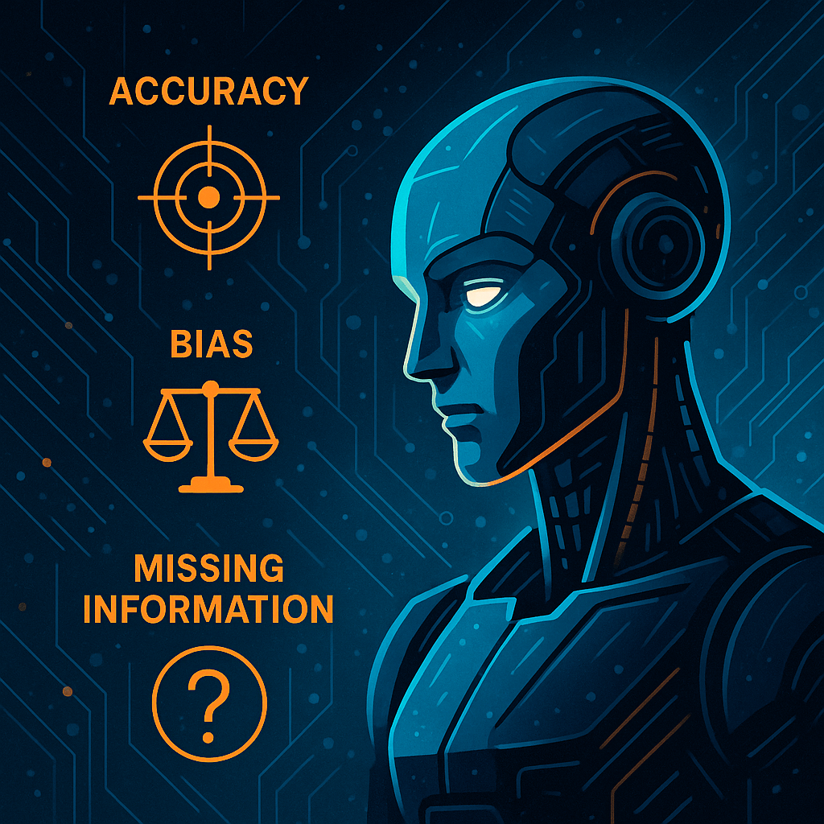
Assessing Accuracy, Bias, and Missing Information in AI Responses
Criteria | Questions to Ask | Prompts for AI | Example in Plain Terms
Accuracy | Is it true? Is it supported with evidence? | What are your sources? Give another perspective. | AI claims a medical stat—verify on CDC/WHO, not just trust.
Bias | Is it one-sided? Any assumptions? Does it feel judgmental? | Give another perspective. What assumptions might be present? | AI writes U.S.-only history narrative—misses global context.
Missing Information | Are key details absent? Do I need to cross-check? | What information is missing? What should we also know? | AI explains WWII causes but leaves out economics/context.
Notes:
Assessing Accuracy, Bias, and Missing Information
Speaking Notes:
“Even when AI is used safely, we still have to check the quality of its output. The three biggest things to watch are accuracy, bias, and missing information.
First, accuracy: Is what the AI produced actually true? Is it supported with evidence? A quick test is to underline any statement that looks like a fact and ask: Where’s the source? For example, if AI says ‘20% of students drop out in the first year,’ we should confirm it on a trusted site like NCES or CDC, not just accept it.
Second, bias: AI reflects patterns in its training data. If most of its sources are Western or English-only, its answers may leave out important perspectives. An AI-generated history summary might describe WWII entirely from the U.S. perspective and miss the global context. Students need to ask: Is this one-sided? Does it assume something unfair?
Finally, missing information: AI often leaves out important context. Maybe it explains the cause of a war but leaves out the economic factors. Or it lists lab steps but leaves out the safety warnings. Asking what’s not here? is just as important as fact-checking what is.
We can teach students simple prompting strategies too: ask AI for another perspective, ask for sources, or specifically say, ‘What information is missing?’ By modeling this, we build critical thinking alongside AI literacy.”
Key Points:
Accuracy: underline facts → verify sources.
Bias: watch for one-sided or unfair assumptions.
Missing info: ask what’s not included?
Faculty can model critical prompts to build student habits.

Slide 5

Understanding Bias and Hallucinations in AI
Definition of Bias
  Bias in AI reflects prejudice present in the training data, influencing outputs unfairly.
Definition of Hallucinations
  Hallucinations occur when AI confidently invents false information without basis in data.
Examples of Bias and Hallucination
  Bias example: AI defaults to male pronouns; Hallucination example: incorrect capital city claim.
Managing Bias and Hallucinations
  While elimination is impossible, quickly spotting bias and hallucinations improves AI use and trust.
Notes:
Understanding Bias and Hallucinations in AI
Speaking Notes:
“Two terms come up often in AI conversations: bias and hallucinations.
Bias is when AI outputs reflect prejudices or patterns in its training data. For example, if AI always assumes a nurse is female or defaults to using male pronouns, that bias came from patterns in the data. It’s not intentional, but it reproduces unfair assumptions.
Hallucinations are when AI simply makes things up—and it does so with complete confidence. It might invent a citation that doesn’t exist, or state a false fact, like naming the wrong capital of a country. These are especially dangerous because they sound authoritative, and students may not think to double-check.
The key is not to expect bias and hallucinations to disappear—they are built-in risks. Instead, we teach students to spot them quickly. One class activity could be showing students an AI-generated essay and asking them to highlight one biased phrase and one hallucinated fact. By doing this, students learn to treat AI critically, the same way we ask them to critique a source in a research paper.
When we acknowledge these weaknesses and teach strategies for managing them, students not only learn AI literacy—they also build stronger skills in skepticism, verification, and fairness.”
Key Points:
Bias = unfair patterns in data (e.g., gender assumptions).
Hallucinations = confident falsehoods (e.g., fake citation, wrong fact).
Expect them; train students to spot and check quickly.
Classroom activity: highlight one bias + one hallucination in an AI output.

Slide 6
Decision-Making for Safe AI Use

Slide 7
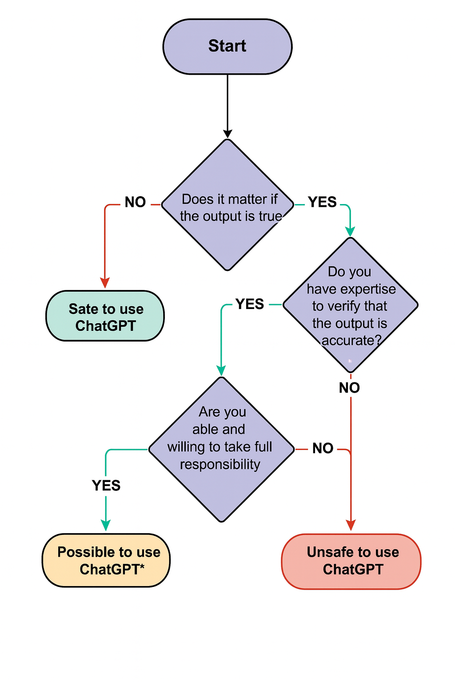
Flowchart for Determining Safe vs. Unsafe AI Applications
Truth Importance
  Determine if the accuracy and truthfulness of AI output are critical for the task at hand.
Expertise Verification
  Assess whether you have the necessary expertise to verify the AI's output effectively.
Responsibility Acceptance
  Consider willingness to take responsibility for any errors resulting from AI application use.
Notes:
Flowchart for Determining Safe vs. Unsafe AI Applications
Speaking Notes:
“This flowchart gives us a practical way to decide: Is it safe to use AI in this situation, or not? The first question is simple: does the truth really matter here? If the accuracy doesn’t matter—like brainstorming icebreaker questions—then it’s safe to use. But if the truth does matter, then we need to move down the chart.
The next question is about expertise. Do I have the knowledge to verify what the AI produced? For example, if AI summarizes a peer-reviewed article, a faculty member has the expertise to fact-check it—but a student may not. If the answer is no, then it’s unsafe.
Finally, even if we have expertise, we must ask: Am I willing to take full responsibility for this output? If I’m drafting a policy email, am I ready to sign my name to it after reviewing it? If the answer is no, then we can’t let AI make that call. This chart helps us frame AI as a partner, not an authority.”
Key Points:
Ask 3 questions: Truth → Expertise → Responsibility.
Safe when accuracy isn’t critical (e.g., brainstorming).
Unsafe if truth matters but can’t be verified.
Final check: Would I sign my name to this?

Slide 8

Examples of Safe and Unsafe AI Use Scenarios
Safe AI Tasks
  Writing poems and brainstorming icebreakers are safe AI uses that encourage creativity and informal assistance.
Conditional Safe Use
  Summarizing peer-reviewed research is safe only if the AI output is carefully verified for accuracy.
Unsafe AI Applications
  Using AI to write legal advice is unsafe due to the critical need for professional accuracy and liability.
User Responsibility
  AI safety depends more on the user’s critical thinking than on the AI tool itself.
Notes:
Examples of Safe and Unsafe AI Use Scenarios
Speaking Notes:
“Here are some practical examples we can share with students. Safe uses include low-stakes creative work like writing poems or brainstorming icebreakers. These build creativity and confidence, and mistakes don’t carry consequences.
Conditional safe use means the task is only safe if someone verifies the AI output. For instance, summarizing peer-reviewed research can be helpful, but only if the instructor or student checks it against the original article.
Unsafe uses are the ones that carry legal, medical, or ethical weight. Using AI to generate legal advice or write medical instructions is unsafe because these require licensed expertise and carry liability.
And finally, we remind students: AI safety depends less on the tool and more on the user’s responsibility. The same tool that’s safe for brainstorming can be unsafe if used uncritically for high-stakes decisions.”
Key Points:
Safe = low-stakes creative tasks.
Conditional = safe only with human verification.
Unsafe = legal, medical, grading, liability-heavy tasks.
Core message: user responsibility matters most.

Slide 9

When to Trust AI: Case Study and Lessons Learned
Timing of AI Trust
  The critical question is when to trust AI, not simply if AI can be trusted in all situations.
Case Study Insight
  AI-generated literacy coaching text appeared accurate but contained hallucinations caught by teachers.
Importance of Verification Partners
  Verification partners are essential as a single person may overlook AI errors or hallucinations.
Notes:
When to Trust AI: Case Study and Lessons Learned
Speaking Notes:
“The question is not ‘Can I trust AI?’ but rather ‘When should I trust AI?’ Trust is situational. For example, in one case, AI was used to generate literacy coaching materials. The text looked accurate at first glance, but teachers discovered hallucinations—statements that sounded right but were false.
The lesson is that AI can produce something convincing, but convincing doesn’t equal correct. That’s why verification partners are so important. When one person reviews AI output, errors can slip through. But when we add a second reviewer—a peer, a supervisor, or even the students themselves—we reduce those risks.
This is the habit we want to instill: AI can assist, but outputs must be cross-checked by people before we rely on them in classrooms, policies, or professional settings.”
Key Points:
The real question is when, not if, we trust AI.
Case study: AI-generated text looked accurate but contained errors.
Verification partners (peer review) catch what one person might miss.
Convincing ≠ Correct — always double-check.

Slide 10
Copyright vs. Plagiarism: Definitions and Implications
Concept | Definition | Layman’s Terms
Copyright | Legal right of ownership (Statute of Anne, 1710). | Breaking the law.
Plagiarism | Ethical violation: using someone’s work without credit. | Breaking trust.
Notes:
Copyright vs. Plagiarism: Definitions and Implications
Speaking Notes:
“When students ask about AI and academic integrity, we often need to separate copyright from plagiarism.
Copyright is a legal issue—it’s about ownership. If someone uses copyrighted material without permission, they’re breaking the law. For example, reproducing a textbook chapter without permission violates copyright.
Plagiarism is an ethical issue—it’s about honesty and trust. Even if something isn’t copyrighted, if a student passes off someone else’s work, or AI’s work, as their own without credit, that’s plagiarism. That’s not breaking the law, but it is breaking trust with the teacher, the class, and the institution.
This slide gives us a simple way to explain: copyright is about law, plagiarism is about trust. Both matter, and both must guide how we teach students to use AI responsibly.”
Key Points:
Copyright = legal (ownership) → breaking the law.
Plagiarism = ethical (honesty) → breaking trust.
AI raises both issues, but plagiarism is most common in the classroom.
Simple framing: law vs. trust.

Slide 11

Plagiarism Challenges with AI-Generated Content
Blurred Originality Lines
  AI generates new text based on existing data, making it difficult to distinguish original from borrowed content.
AI-Assisted Ethical Revision
  Example of AI revising a teacher's paragraph to add ethical nuance and clarity, enhancing content quality.
Ethical Use Prompt
  Raises the question if students should cite AI when using it for text revision to ensure academic honesty.
Notes:
Plagiarism Challenges with AI-Generated Content
Speaking Notes:
“AI introduces new challenges with plagiarism because it blurs originality lines. AI generates new sentences, but those are based on patterns from existing data. That makes it difficult to tell where original ends and borrowed begins.
There are also legitimate ways AI can help, such as AI-assisted ethical revision. For example, an instructor could paste a rough paragraph into AI and ask it to suggest clearer, more professional wording. The core ideas remain the instructor’s—AI just polishes the text. That’s very different from asking AI to write an entire essay from scratch.
This raises the big question: Should AI be cited when it’s used? If a student uses AI to revise their draft, do they need to disclose that? The answer may depend on the assignment, but raising the question teaches students that transparency matters. We don’t want to ban tools—we want to model ethical use. Students should see AI as a partner they acknowledge, not a ghostwriter they hide.”
Key Points:
AI blurs originality → hard to separate original vs. borrowed.
Ethical revision = keeping ownership, using AI to clarify/polish.
Main issue: disclosure — when and how to cite AI use.
Teaching focus: transparency and ethical partnership with AI.

Slide 12
Teaching Responsible AI Use

Slide 13
Eaton’s Six Tenets for AI and Plagiarism
Tenet | Plain Explanation | Example
Control vs. Responsibility | You can let AI help, but responsibility is still yours. | Using AI to draft—still responsible for errors.
Attribution Matters | Always give credit. | “Generated with ChatGPT, edited by [Name].”
Old Definitions Don’t Apply | Hybrid writing differs from copying. | AI rewording vs. plagiarism distinctions.
Language Barriers Shrink | AI can translate and clarify. | ESL student uses AI for clarity.
Creativity Expands | AI sparks new approaches. | Brainstorming metaphors or examples.
Hybrid Writing Normal | Human + AI collaboration is expected. | Students submit drafts with AI‑assisted revision logs.
The QMA Singularity(blog) – Arxiv paper- YouTube
AI won’t replace thoughtful people—it will supercharge thoughtful people who know how to choose good targets and steer it well.
Notes:
Two researchers were stuck on a nasty math problem. They asked a top model for help. The first answer was wrong. Instead of dunking on it, they explained why. The model tried again. Within about thirty minutes, it suggested the missing idea that unlocked the proof. Could the humans have found it on their own with a week of grinding? Sure. The point is speed. AI didn’t replace judgment. It made good judgment go further.
Eaton’s Six Tenets for AI and Plagiarism
Speaking Notes:
“Eaton outlines six tenets that help frame how we handle AI and plagiarism in education.
First, Control vs. Responsibility: AI can help with drafting, but responsibility never transfers. If a student uses AI to write, they are still accountable for what it produces. That’s why we remind them: if AI makes an error, it’s your name on the assignment.
Second, Attribution Matters: Giving credit is essential. Just like citing a source, students should disclose when AI contributed. A simple example might be: ‘Generated with ChatGPT, edited by [Name].’ This doesn’t mean AI gets authorship—it means students are transparent about its role.
Third, Old Definitions Don’t Apply: Traditional plagiarism rules don’t always fit hybrid AI writing. For example, rewriting with AI isn’t the same as copy-pasting. We need to refine policies that reflect these distinctions.
Fourth, Language Barriers Shrink: AI can help ESL students by translating or clarifying their writing. This is not cheating—it’s scaffolding that makes learning more accessible.
Fifth, Creativity Expands: AI can generate new metaphors, examples, or prompts that expand thinking. It’s not about replacing creativity but sparking new directions.
And finally, Hybrid Writing Normal: Human + AI collaboration will be standard. Our job is to prepare students for that reality by teaching disclosure and ethical practice.”
Key Points:
Responsibility stays with the student/faculty.
Attribution = always give credit.
Hybrid AI writing differs from old plagiarism models.
AI breaks down language barriers.
AI can expand creativity.
Hybrid human+AI writing will be normal

Slide 14
Cultural Bias in AI-Generated Images
Example of Cultural Bias
AI-generated images often reflect dominant cultural norms, such as Western-style classrooms for 'engaged learners'.
Need for Verification
AI images can misrepresent engagement and cultural contexts, requiring careful review and verification.
Re-prompting for Accuracy
Adjusting AI prompts can help better capture diverse cultural expressions of engagement in learning environments.
Notes:
Cultural Bias in AI-Generated Images
Speaking Notes:
“AI images are not neutral. They reflect cultural assumptions based on their training data. For example, if you ask AI to generate a picture of an ‘engaged classroom,’ it often defaults to a Western-style setting: students at desks, hands raised. But that’s not what every culture considers ‘engagement.’
This is why verification is necessary. An AI image may look polished but misrepresent reality. Imagine a global history textbook illustrated entirely by AI—it could unintentionally exclude cultural diversity and reinforce narrow norms.
One strategy is re-prompting for accuracy. If the first image is biased, refine the prompt: ask for classrooms from different regions, or for more varied expressions of learning. By doing so, we model for students that AI outputs can be adjusted to better reflect diverse perspectives.”
Key Points:
AI images often reinforce dominant cultural norms.
Verification is needed to avoid misrepresentation.
Re-prompting helps capture diverse perspectives.

Slide 15
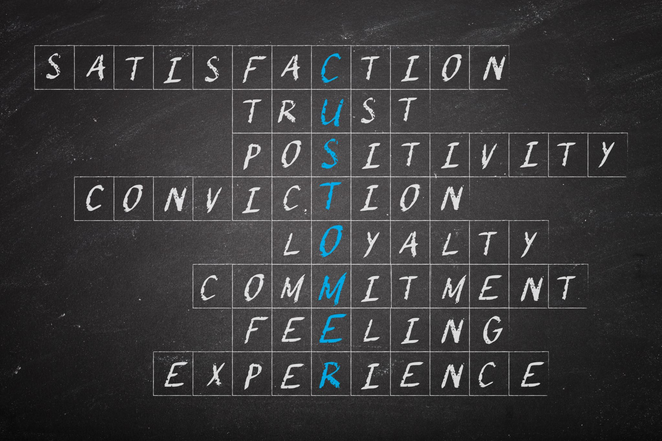
Scaffolding AI and Plagiarism Education with Bloom’s Taxonomy
Bloom’s Taxonomy Steps
  Education progresses through six stages: Remember, Understand, Apply, Analyze, Evaluate, and Create to deepen learning.
Case Example Discussion
  Use the 2023 Sports Illustrated 'fake writers' story to spark conversation about AI and plagiarism ethics.
Ethical Scaffolding Approach
  Educate students to move beyond banning AI by developing their own ethical guidelines and critical thinking skills.
Notes:
Scaffolding AI and Plagiarism Education with Bloom’s Taxonomy
Speaking Notes:
“We can scaffold AI and plagiarism discussions using Bloom’s Taxonomy. Learning builds from simple to complex: remembering, understanding, applying, analyzing, evaluating, and creating.
At the lower levels, AI can assist students with remembering and understanding—like summarizing an article or translating complex language. But at higher levels, such as analyzing and creating, students must do the heavy lifting. AI might provide suggestions, but critical thinking and originality must come from them.
We can also anchor this discussion with real-world cases. For example, the Sports Illustrated ‘fake writers’ scandal—where AI-created authors were published without disclosure—raises questions of transparency and ethics. This sparks rich conversations about what counts as authorship, responsibility, and originality.
Ultimately, instead of banning AI, we use scaffolding to teach ethics and critical judgment. Students develop their own guidelines, making them active participants in responsible AI use.”
Key Points:
Bloom’s shows where AI is helpful (lower levels) vs. where students must lead (higher levels).
Case studies (e.g., Sports Illustrated fake writers) spark discussion.
Goal: scaffold students toward ethical self-regulation.

Slide 16

Classroom Guidelines for Appropriate and Inappropriate AI Use
Appropriate AI Uses
  AI can be effectively used as an aggregator, tutor, brainstorming partner, feedback provider, and copy editor in classrooms.
Inappropriate AI Uses
  Avoid lazy prompting, no meaningful effort, and submitting AI-generated work without revision or understanding.
AI Limitations
  AI may hallucinate 3–8% of the time and has built-in biases; students must verify and take responsibility for final outputs.
Notes:
Classroom Guidelines for Appropriate and Inappropriate AI Use
Speaking Notes:
“In the classroom, students need clear lanes: when AI is appropriate and when it is not.
Appropriate uses include having AI act as an aggregator, tutor, brainstorming partner, or feedback provider. For example, AI might help rewrite a draft for clarity or suggest discussion questions.
Inappropriate uses are things like lazy prompting—typing a vague request and copying the output—or submitting AI-generated work with no effort, revision, or understanding. Students must still demonstrate learning and personal insight.
Finally, we must be honest about AI limitations. Even the best systems hallucinate 3–8% of the time and inherit bias from training data. That’s why the student, not the AI, is always responsible for the final submission. The goal is to model AI as a helper, never as a shortcut.”
Key Points:
Appropriate: tutoring, brainstorming, clarity edits.
Inappropriate: lazy prompting, uncritical copying.
AI limits: hallucinations + bias remain.
Students must own and verify final work.

Slide 17
Transparency and Assignment Design

Slide 18
Levels of AI Use and Disclosure
Level | Description | Disclosure Requirement | Example
0 | No AI use allowed. | No disclosure required. | Timed in‑class essay.
1 | AI for idea generation/structuring. | Must disclose how AI was used. | Outline building.
2 | AI for editing/polish. | Must cite (MLA/APA). | Grammar check and wording improvements.
3 | AI for task completion (drafting). | Must cite and accept responsibility for output. | Drafting summaries with human verification.
4 | Full AI use with human oversight. | Must cite + provide a co‑pilot/usage log. | Research notes heavily AI‑assisted but human‑edited.
Notes:
Levels of AI Use and Disclosure
Speaking Notes:
“This framework lays out different levels of AI use and what disclosure looks like at each.
At Level 0, no AI is allowed. For example, a timed in-class essay where students demonstrate their own unassisted skills. No disclosure is needed because AI isn’t part of the process.
At Level 1, students may use AI for idea generation and structuring—like asking it to brainstorm topics or help create an outline. Here, disclosure is required: students must explain how AI was used.
At Level 2, AI may be used for editing or polishing, such as grammar checks or rewording for clarity. At this level, citation is required—students need to acknowledge AI as a tool used, following citation standards like MLA or APA.
At Level 3, AI may be used for drafting content, but the student must cite the tool and take full responsibility for verifying accuracy.
Finally, at Level 4, students can make full use of AI with human oversight, but they must document usage, often through a log or co-pilot report. This makes the process transparent and emphasizes accountability.
This kind of structure helps us clarify expectations. It prevents the blanket ‘all or nothing’ approach and instead shows students how to use AI responsibly at different levels of engagement.”
Key Points:
Level 0: No AI (timed essay).
Level 1: Brainstorming/structuring → must disclose.
Level 2: Editing/polish → must cite.
Level 3: Drafting → must cite + verify.
Level 4: Full use with oversight → cite + usage log.
Provides clear guardrails instead of “all or nothing.”

Slide 19

Designing Assignments to Resist AI Misuse
Personal Connections and Reflections
  Assignments requiring personal insights encourage unique responses that AI cannot easily replicate.
Oral Defenses and Viva Checks
  Oral presentations verify understanding and originality beyond written submissions.
Localized Case Studies
  Using local data ties assignments to specific contexts, limiting AI applicability.
In-person Collaborative Work
  Group activities in-person reduce chances of AI misuse and foster teamwork.
Notes:
Designing Assignments to Resist AI Misuse
Speaking Notes:
“Assignments can be designed in ways that make it harder to misuse AI and easier to encourage authentic work.
One strategy is requiring personal connections and reflections. AI can’t replicate a student’s unique experience, so asking for personal insights makes the work their own.
Another is oral defenses and viva checks. A quick follow-up presentation or explanation verifies that students understand their submission beyond the written words.
Localized case studies also help. If you tie assignments to local data or specific community issues, AI is less likely to generate relevant content, and students are pushed to engage with their actual context.
Finally, in-person collaborative work adds accountability. Group work in class creates authentic exchanges and reduces reliance on AI alone.
In short, we don’t just need to police AI—we can design smarter assignments that encourage originality, reflection, and understanding.”
Key Points:
Use personal reflections (AI can’t replicate).
Add oral defenses to confirm learning.
Assign local case studies AI can’t easily fake.
Build in in-person collaboration to reduce misuse.

Slide 20

Key Questions for Responsible AI Integration
Responsible AI Support
  Identify areas where AI can responsibly enhance learning and productivity in your work environment.
Risks of Unchecked AI
  Recognize the potential dangers and risks associated with unregulated or unchecked AI deployment.
Evolving Plagiarism Policies
  Consider how plagiarism policies should be updated to address challenges posed by AI technologies.
Core Principles
  Responsible AI use requires awareness, proper attribution, and accountability to ensure ethical integration.
Notes:
Key Questions for Responsible AI Integration
Speaking Notes:
“As we wrap up, here are four guiding questions for responsible AI use.
First: Where can AI responsibly support learning or productivity? For example, could it speed up drafting so students can spend more time analyzing? Could it help faculty with routine prep work?
Second: What are the risks of unchecked AI? This includes hallucinations, bias, and over-reliance. If we don’t check its outputs, we risk students trusting false information or bypassing their own learning.
Third: How should plagiarism policies evolve? Traditional plagiarism was about copying a person’s work. Now, we need to decide how disclosure, citation, and transparency apply when AI is involved.
And fourth: What are our core principles? At the end of the day, responsible AI use requires awareness, attribution, and accountability. If we keep those principles front and center, we can adapt to new tools without losing integrity.”
Key Points:
Where can AI add value?
What risks emerge if unchecked?
How should plagiarism policies evolve?
Core principles: awareness, attribution, accountability.
Closing / Wrap-Up
Speaking Notes:
“To bring this all together: AI is moving fast, but our role is to guide its responsible use in education. We don’t need to ban it, but we also can’t ignore its risks. By treating AI as a tool, setting clear boundaries, teaching critical evaluation, and modeling ethical use, we prepare our students for both academic success and the workforce they’re entering.
The goal is not just to keep up with AI, but to teach students how to use it with integrity, judgment, and creativity. That way, when AI becomes a normal part of their professional lives—as it surely will—they’ll already have the habits to use it responsibly.”
Key Points:
AI is a tool, not a replacement.
Our job: guide, supervise, and contextualize.
Teach evaluation: accuracy, bias, missing info.
Prepare students for a future where AI is normal.

