Slide 1

Multimedia Presentation
Seminal Research
Group 3
April 6, 2022

Slide 2
Presenters
ELIZABETH MALIN
ebbyfuentes@gmail.com
LASHUNDA BRATHWAITE
lashundabrathwaite@gmail.com
MEILIN JIANG
meilinjiang@my.unt.edu
STEPHANIE L. ROBINSON
stephanie@stephanielrobinson.com
LANCE WHISENANT
mwhisenant13@gmail.com
TALIAH ALESKANDRANY
MICHAEL A. JOHNSON
taliahales@my.unt.edu
michaeljohnson.unt@gmail.com

Slide 3
Overview
The purpose of our presentation is to provide an overview of several seminal research publications. Our goal is to provide a well-rounded and informative discussion on issues such as Connectivism, Cognitive Theory of Multimedia Learning, Adult Learning Theory, Cognitive Affective Theory, SAMR, and others.
With that being said, let’s dive in!

Slide 4
Contents
Stephanie Robinson
Lance Whisenant
Elizabeth Malin
Meilin Jiang
Cognitive-Affective Theory
Connectivism
Constructivism
Behaviorism Theory
Taliah A.
LaShunda Brathwaite
Michael A. Johnson
Animation
Adult Learning Theory
SAMR Model

Slide 5
01
Cognitive-Affective Theory of Learning with Media
Stephanie L. Robinson

Slide 6
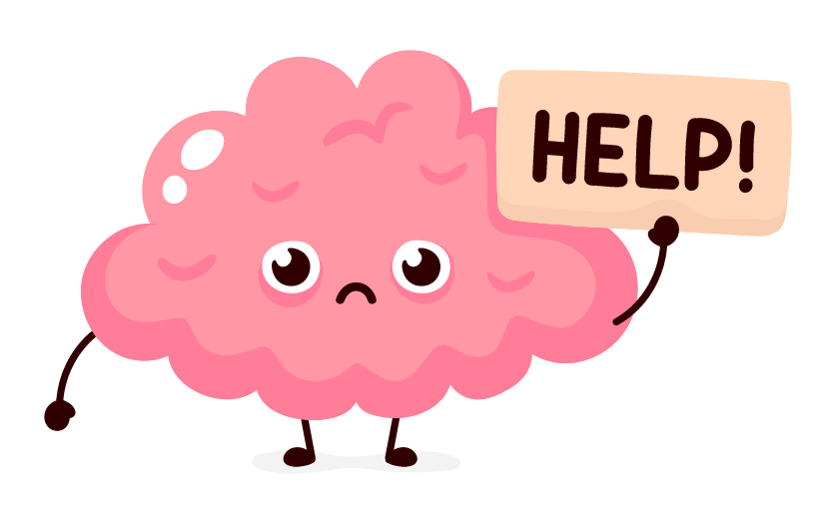
Cognitive-Affective Theory of Learning with Media (CATLM)
Proposed by Roxana Moreno (2006) to address issues related to Cognitive Load in the learning process.

Slide 7
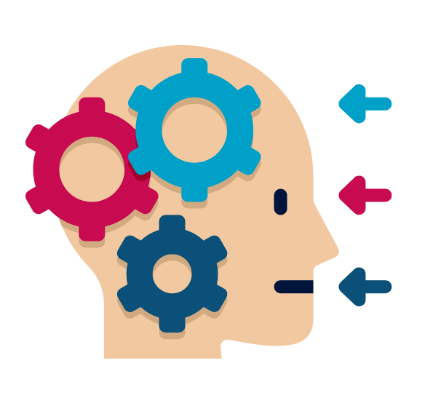
Cognitive-Affective Theory of Learning with Media (CATLM)
What is Cognitive Load?
Relates to the amount of information that working memory can hold at one time.

Slide 8
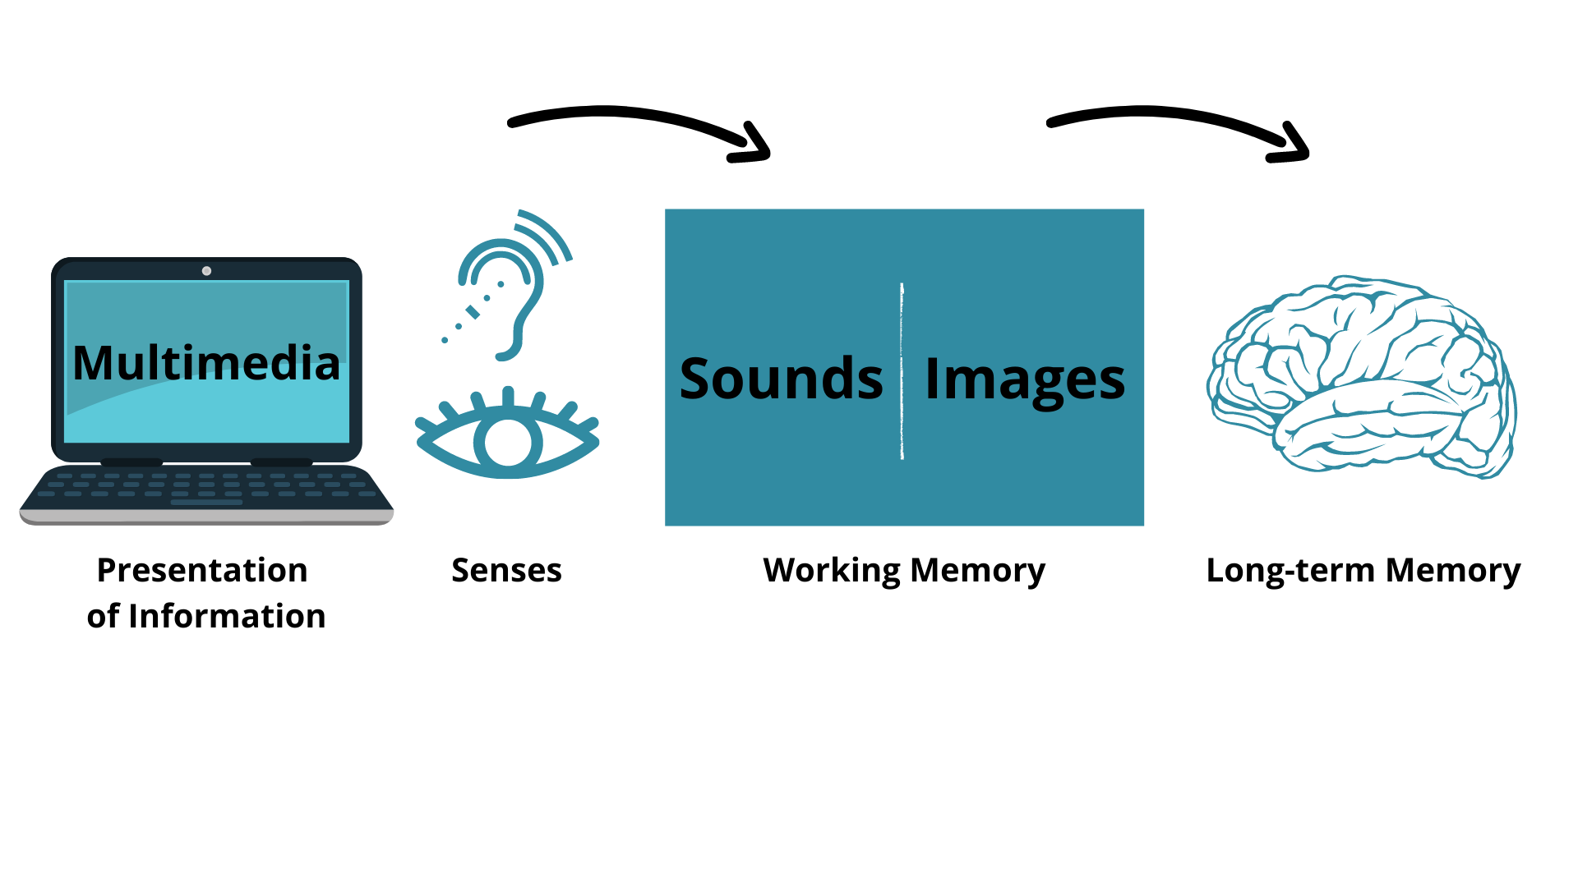
Multimedial Learning Process…

Slide 9
Cognitive-Affective Theory of Learning with Media (CATLM)
Multimedia stimulates learners’ interest and enjoyment.
  Achieving a greater level of motivation to engage in deeper learning!
Motivation mediates learning by increasing or decreasing the amount of cognitive resources a learner invests on the task.
  Higher motivation leads to less cognitive effort.
  Lower motivation leads to higher cognitive effort.

Slide 10
02
Connectivism Learning Theory
Lance Whisenant

Slide 11
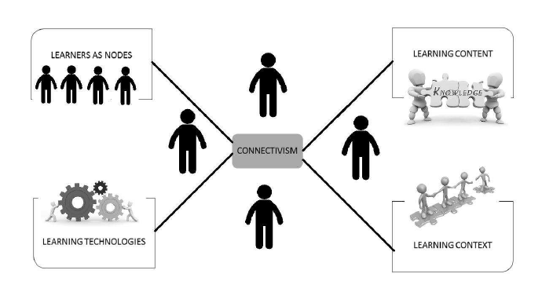

Introduction of Connectivism
Image obtained from: https://www.researchgate.net/figure/A-Connectivist-Framework_fig1_269071838
Image obtained from: https://sites.psu.edu/eliiskeidong/2018/01/27/the-petri-dish-of-learning-the-connectivism/

Slide 12
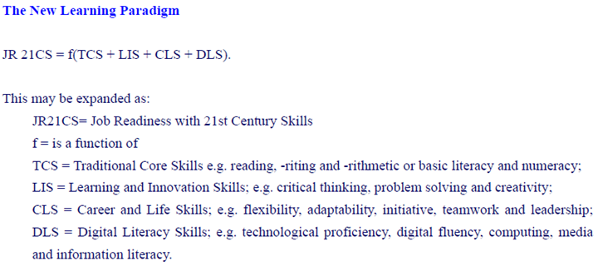
So, what is this exactly…?
And why should I be interested?
Technology, duh!?
The Learners’ Needs
In the last 25 years, technology has changed the way we live and how industries operate.
  I.E., if businesses want to be profitable then they must embrace technology.
Digital Literacy
  Technological proficiency, media and information literacy, etc.
The New Learning Paradigm:
Learning is a process that occurs in a variety of ways.
  Communities, Databases, and the good ol’ Internet.
Learning is continual. You don’t just stop learning…
  Also, how we perceive our learning experience via numerous perspectives is key to learning.
Developing connections is necessary to foster continuous learning.
  Yet, it’s the learners’ ability to make these connections is when learning occurs.
Image obtained from: https://www.sciedu.ca/journal/index.php/ijhe/article/view/5156

Slide 13
The Appeal of Connectivism
Established theories describe learning as occurring within a person, i.e. brain-based learning; such perspectives do not recognize the idea that knowledge, learning, and meaning can be conceptualized as networked elements that exist external of human beings.
Learning landscapes are networked, social, and technological.
Viewing information literacy in terms of connections suggests that connectivism provides a framework for understanding how students learn.
The Practicality of Connectivism
21st Century Job Skills
Learning & Innovation Skills
Career & Life Skills
Digital Literacy Skills
Flexibility, Adaptability, & Cross-Cultural Interaction
Creativity & Innovation

Slide 14
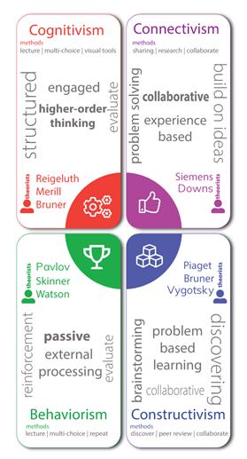
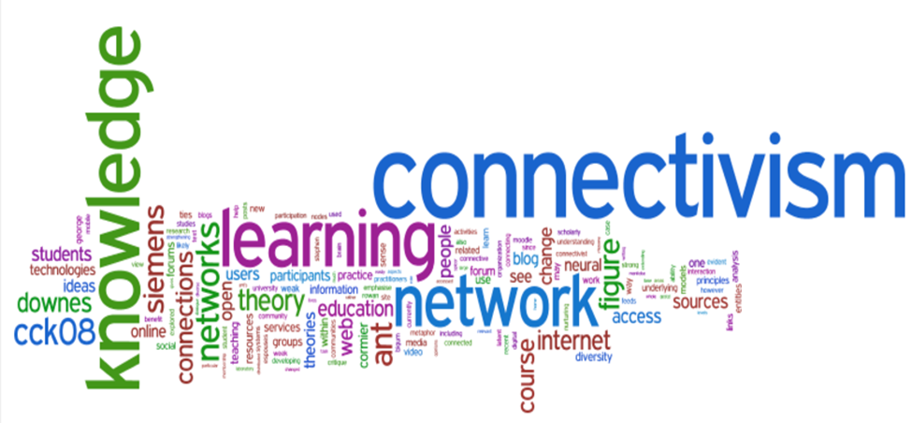
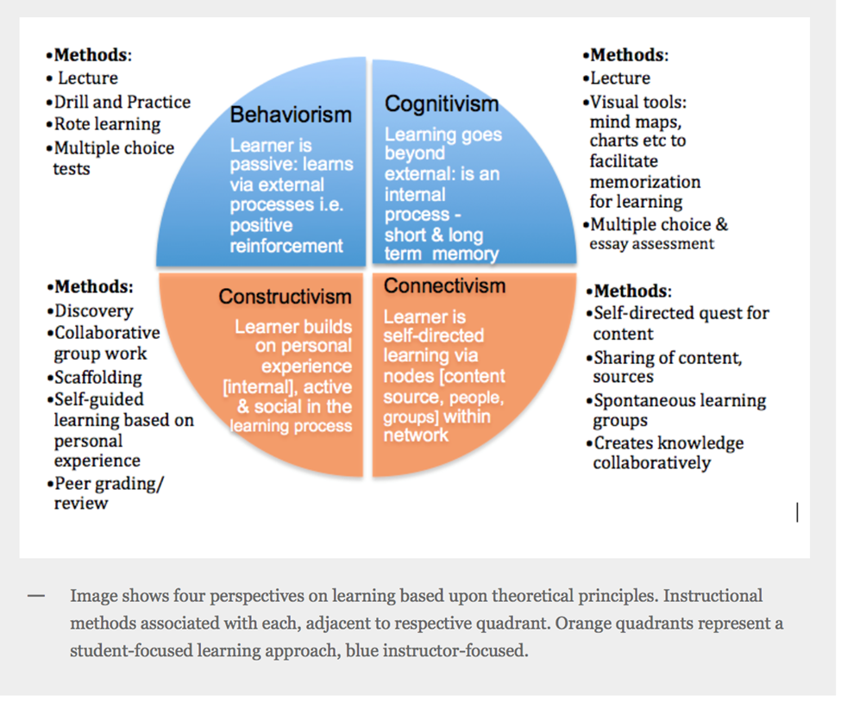
In Conclusion…
Image obtained from: https://www.semanticscholar.org/paper/Connectivism%3A-a-network-theory-for-teaching-and-in-Bell/60a77352fd18c857506f0e9bed109fd147a42b9d
Image obtained from: https://brendaclawson.com/final-reflection-instructional-design/
Image obtained from: https://pypinub.wordpress.com/2014/11/09/four-learning-theories-behaviorism-cognitivism-constructivism-and-connectivism/

Slide 15
03
Constructivism in Multimedia Learning Environments
Elizabeth Malin

Slide 16
Introduction of Constructivism
TPACK Model (2006): Framework for technology integration in the classroom.
Constructivist Learning Environments: allows students to explore and reflect on their learning regarding technology.
Constructivist Learning: A case study (2007).

Slide 17
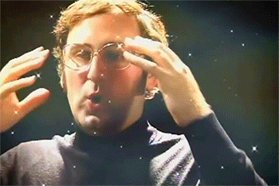
Framework
Dewey (1916) The improvement of the reasoning process is a key furniture of education (Harwood et al. 2017).
Piaget (1973) humans created knowledge through interaction between their experience and ideas Harwood et al. (Harwood et al. 2017).
Vygotsky (1978) details the concept of the Zone of Proximal Development explaining social interaction is the psychological development of the learner (Harwood et al., 2017).
Bruner (1996) stated that the concept of discovery learning implies that students construct their own knowledge for themselves (Harwood et al. 2017).
All agree active learning and the construction of new knowledge is based on prior knowledge and the role of the educator is the facilitar (Harwood et al., 2017).

Slide 18
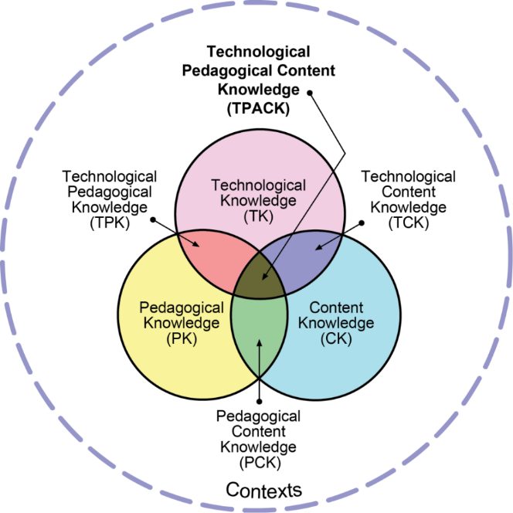
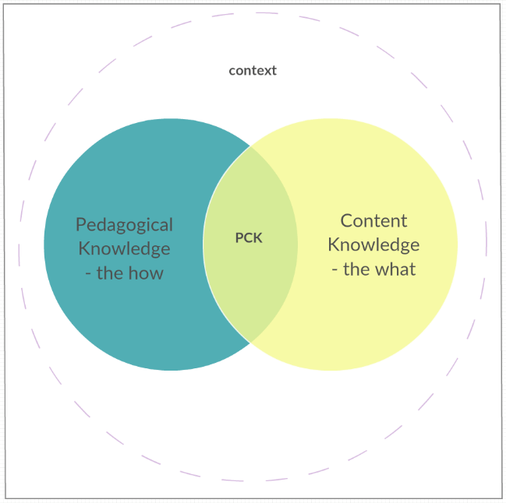
TPACK Model
Adams (2019).
Adams (2019).

Slide 19
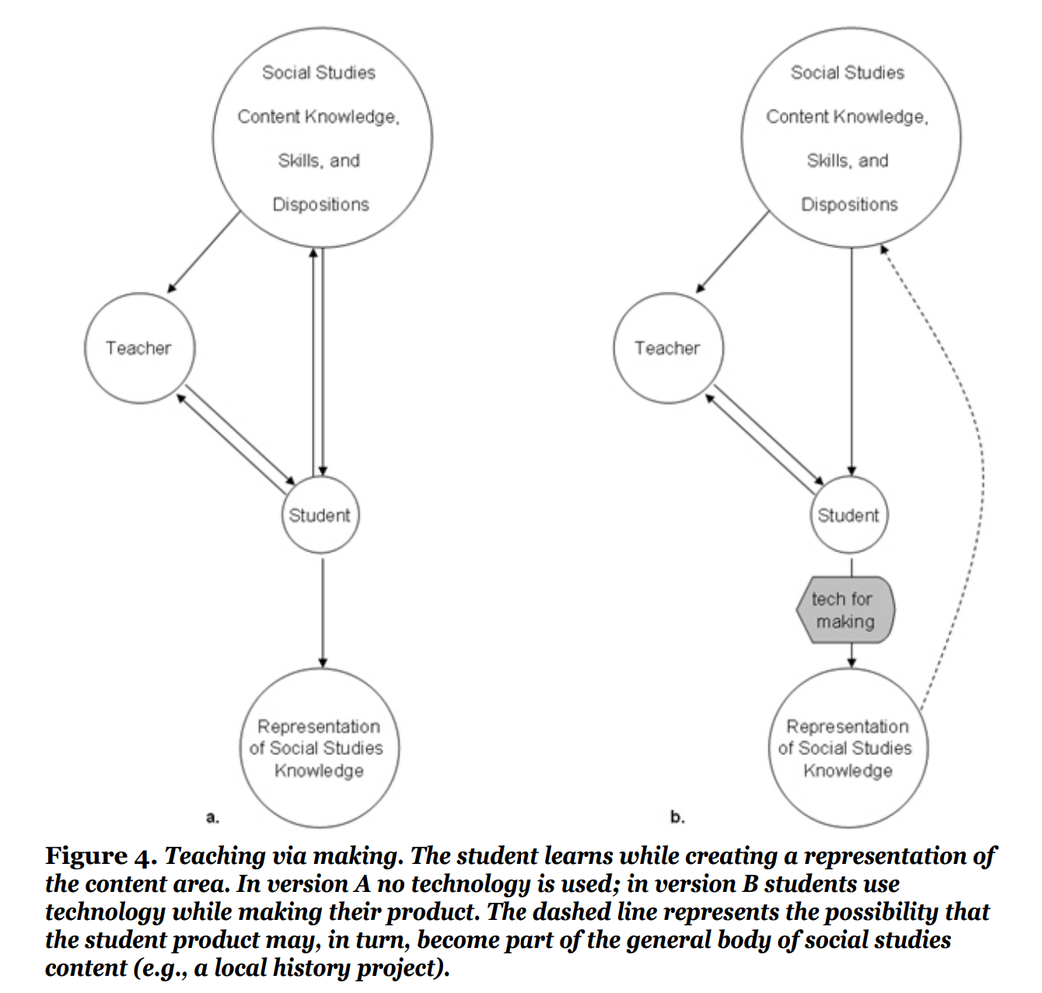
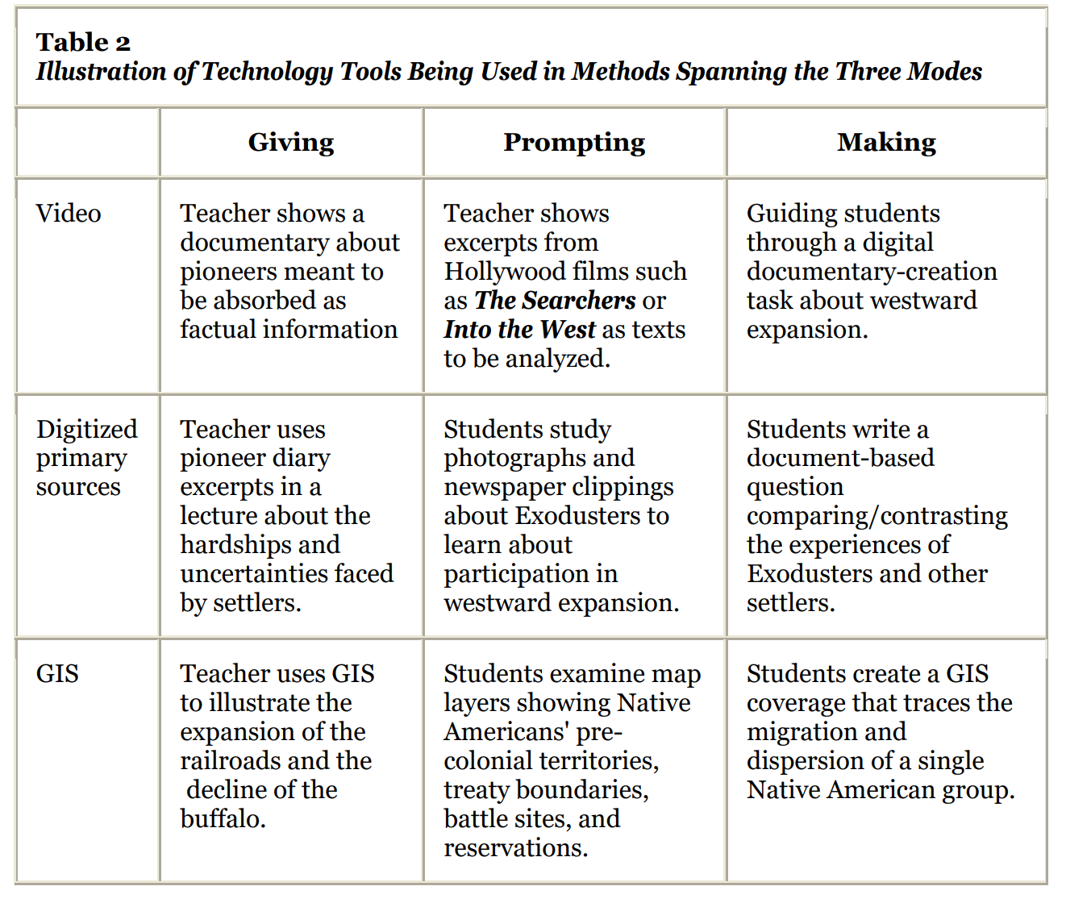
The Giving-Prompting-Making Model and TPACK
Hammond (2009)

Slide 20
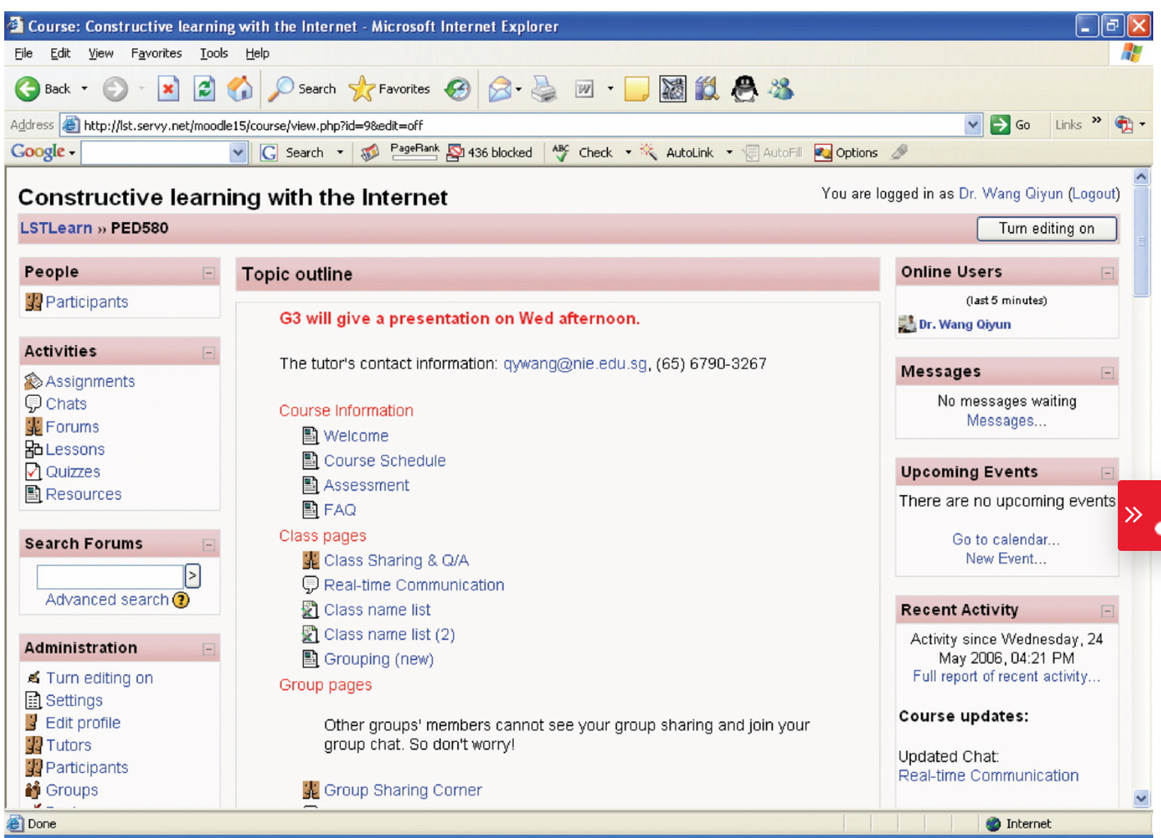
Need for Constructivism: A case study (2007)
Figure 1. The home page of the learning environment (Wang (2009).

Slide 21

Teacher’s Role
Teacher’s Role In Constructivism
Teacher competence affects student performance.
Teacher must be skillful to lead the learning process.
They apply constructivism.
Teacher guides the leaner in the process of teaching and learning-based interactive experiences.
Allow students to choose their own activities in their learning spaces.

Slide 22
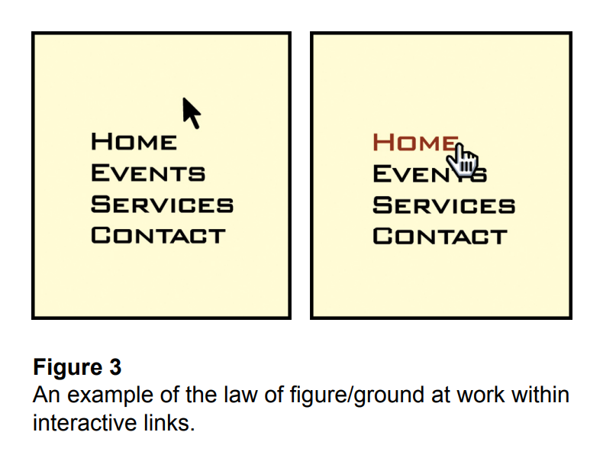
Gestalt Theory

Slide 23
04
Behaviorism Theory in Multimedia learning
Meilin Jiang

Slide 24
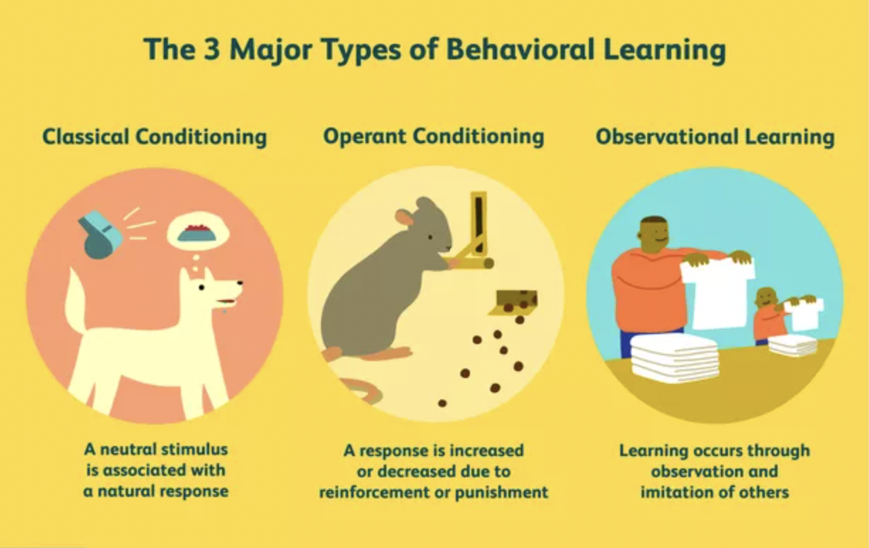
Introduction of Behaviorism Theory
John B Watson(1926) as the founder of Behaviorism Theory
All behavior is the result of conditioning that occurs in response to a stimulus.
Thorndike's (1932) apply the theory in education
Especially learning and transfer. Transfer happened only when the situations have identical elements and call for similar responses.
B.F. Skinner(1930-1950) : skinner box and teaching machines
Behavior is sustained by reinforcements or rewards, not by free will.

Slide 25
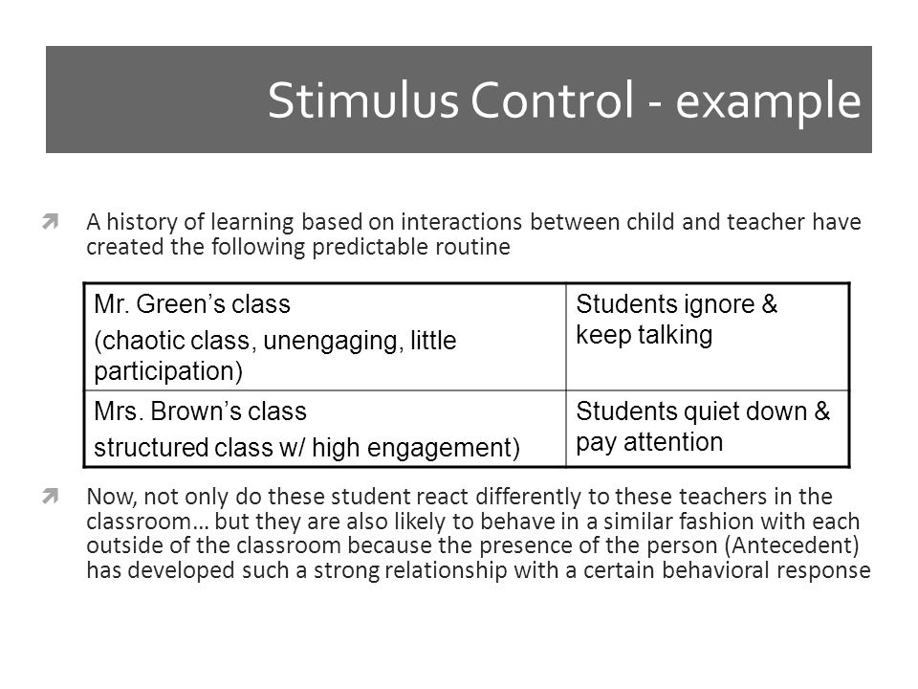
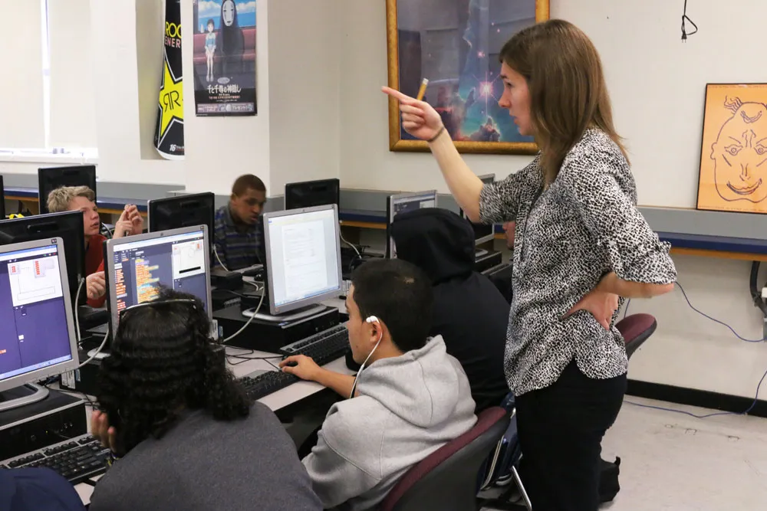
Behaviorism Theory in education
How does Learning occur?
Behaviorism equates learning with changes in either the form or frequency of observable performance. Primary concern: Stimulus and Responses. For example: 2+4=?
Which factors influence learning?
Environmental conditions receive the greatest emphasis.
The most critical factor, however, is the arrangement of stimuli and consequences within the environment.
What is the role of memory?
Memory is not typically addressed by behaviorists.
How does transfer occur?
In Behaviorism learning theories, transfer is a result of generalization.
What application are best explained by this position?
Behaviorism was used as the basis for designing many of the early audio-visual materials.Computer-assisted instruction (CAI) and Mastery learning.

Slide 26


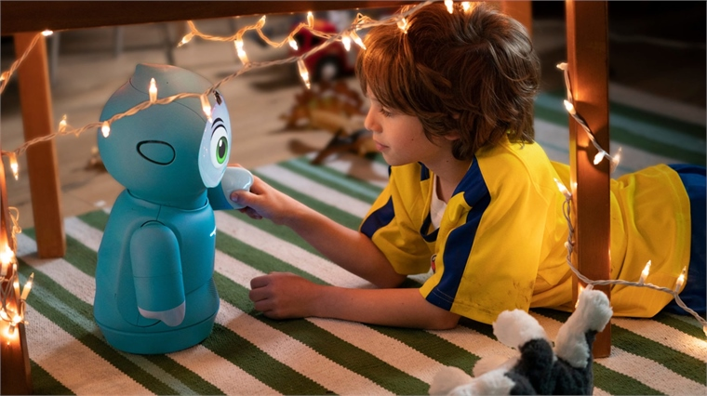
Visual stimulus is “ Brain Compatible”
Visual tools: photographs, video, concept maps, graphs and charts.
Visual stimuli is a brain friendly teaching method.
Visualizing information can aid memory retention and out performs verbal practice.
The moving images as stimulus— Student positive responses.

Slide 27
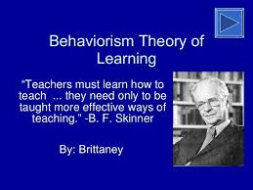
Job of teacher in learning with multimedia
Behavioral theories imply that the job of the teacher is to:
(1) determine which cues can lead the desired responses;
(2) arrange practice situations in which prompts are paired with the target stimuli that initially have no leading to power but which will be expected to lead to the responses in the “natural” (performance) setting;
(3) arrange environmental conditions so that students can make the correct responses in the presence of those target stimuli and receive reinforcement for those responses.

Slide 28
05
“Animation as an aid to multimedia learning”
(Mayer & Moreno, 2002)
Taliah A.

Slide 29
Cognitive Theory of Multimedia Learning
Seminal Research Article: “Animation as an Aid to Multimedia Learning”
Richard E. Mayer & Roxana Moreno (2002)
Based on three assumptions
  Dual-channel assumption
  Limited capacity assumption
  Active processing
Presents seven principles

Slide 30
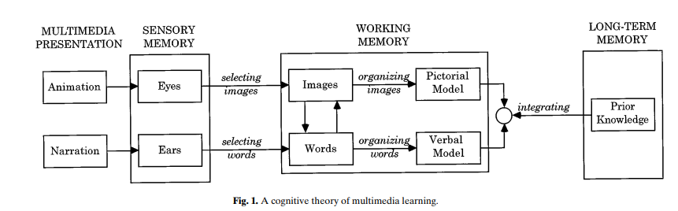
Cognitive theory of multimedia learning
(Mayer & Moreno, 2002)

Slide 31
SEVEN PRINCIPLES FOR USE OF ANIMATION IN MULTIMEDIA INSTRUCTION
Multimedia- animation + narration
Spatial contiguity- text near animation
Temporal contiguity- present simultaneously
Coherence- avoid extraneous words, sounds, video
Modality- animation + narration animation+ text
Redundancy- animation + narration + text
Personalization- conversational style

Slide 32



Animation As An Aid
POTENTIAL TO IMPROVE LEARNING
PROMOTE LEARNER UNDERSTANDING
GUIDE FOR DESIGNERS

Slide 33
06
Adult Learning Theory
LaShunda Brathwaite

Slide 34
Common Adult Learning Theories
Andragogy
Popularized by Malcolm Knowles in 1980’s
  Adults learn differently from kids
  Hands-on experiences and less instruction
Transformative Learning
Developed by Jack Mezirow Knowles in 1970’s.
  Changes the way learners think about the world
  Does not account for relationships, feelings, and cultural context
Experiential Learning
Developed by David Kolb in 1970’s
  Adults are shaped by their experiences
  Active Involvement
  Self Reflection
Developed by Alan Tough in the 1970’s.
  Adult's carry out, and evaluate their learning experiences without the help of others.
  Some adult learners lack the confidence and understanding to do self directed learning well.
Self-Directed Learning
Project-Based Learning
Developed by John Dewey in early 1900’s.
  Learn by doing
  Real world experiences
  Outcomes are unproven

Slide 35
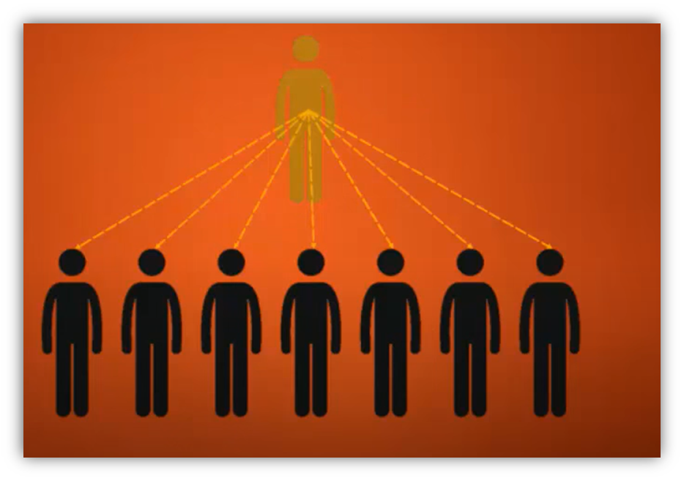
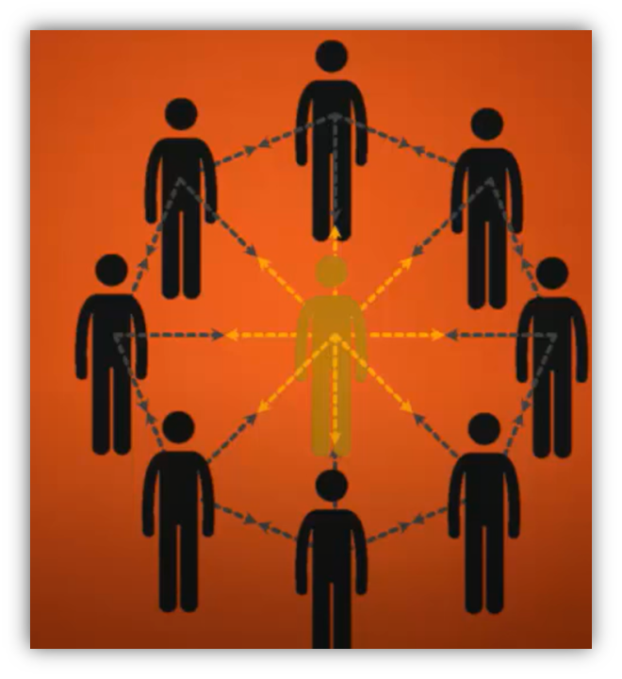
Pedagogy vs. Andragogy
ANDRAGOGY
Mutual respect & collaboration
Planning done with mutual cooperation
Conducive to self-directed learning
PEDAGOGY
Traditional Classroom
Teacher controls planning
Not conducive for self-directed learning

Slide 36
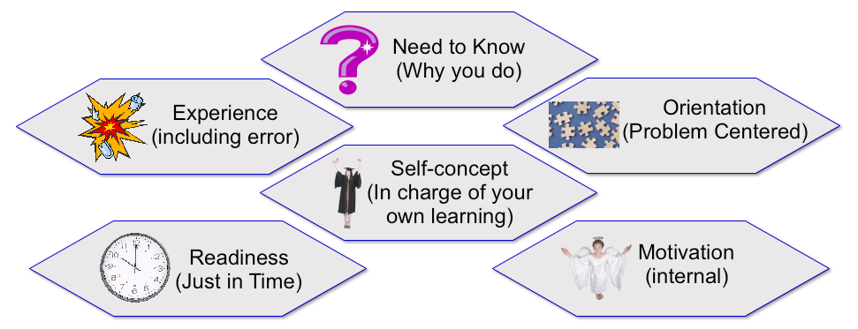
Andragogy
Popularized by Malcolm Knowles in 1980’s
  Need to Know
  Motivation
  Readiness to Learn
  Adult learner experience
  Orientation to Learning
  Self-Concept
Andragogy

Slide 37
Transformative Learning
Concrete Experience
What happened?
Transformative Learning
Developed by Jack Mezirow Knowles in 1970’s.
  Changes the way learners think about the world
  Does not account for relationships, feelings, and cultural context
Active Experimentation
Reflective Observation
What will I do?
What did I experience?
Abstract Conceptualization
Why did this happen?

Slide 38
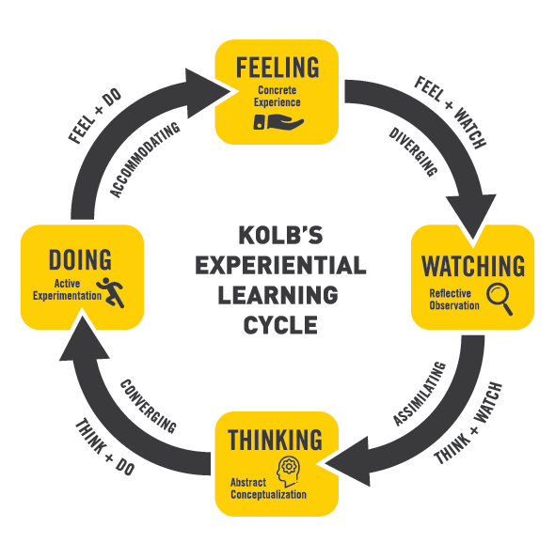
Experiential Learning
Experiential Learning
Developed by David Kolb in 1970’s
  Adults are shaped by their experiences
  Active Involvement
  Self Reflection

Slide 39
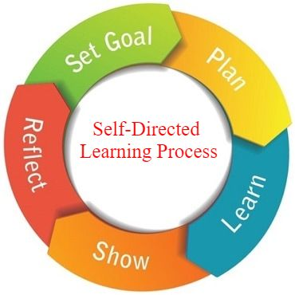
Self-Directed Learning
Self-Directed Learning
Developed by Alan Tough in the 1970’s.
  Adult's carry out, and evaluate their learning experiences without the help of others.
  Some adult learners lack the confidence and understanding to do self directed learning well.

Slide 40

Project Based Learning
Project-Based Learning
Developed by John Dewey in early 1900’s.
  Learn by doing
  Real world experiences
  Outcomes are unproven
“Tell me and I forget, teach me and I may remember, involve me and I learn.”
~ Benjamin Franklin

Slide 41
07
SAMR Model
Substitution, Augmentation, Modification, and Redefinition
Michael A. Johnson

Slide 42
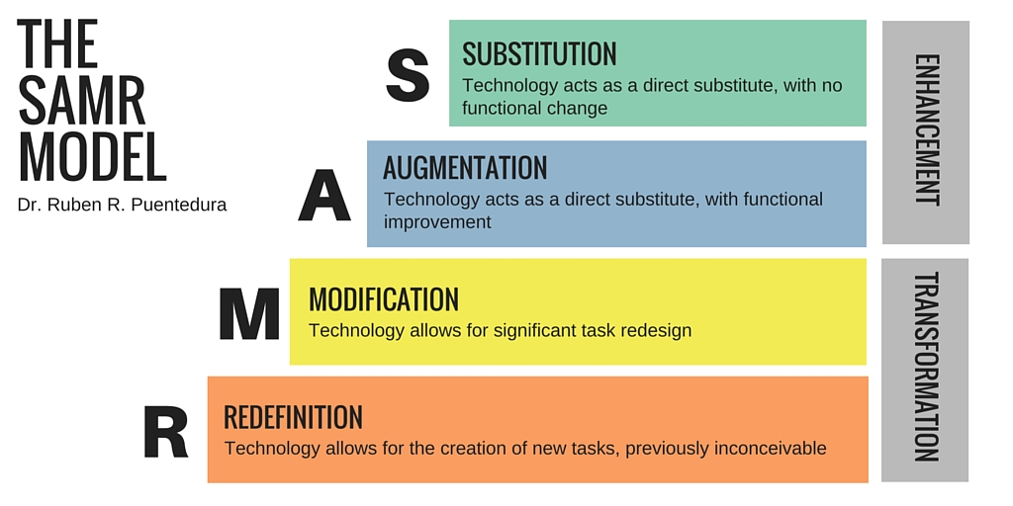
What is it?
Lefflerd. (2016). Explanation of the Samr Model. Wikimedia Commons. Retrieved April 4, 2022, from https://upload.wikimedia.org/wikipedia/commons/5/5e/The_SAMR_Model.jpg.

Slide 43
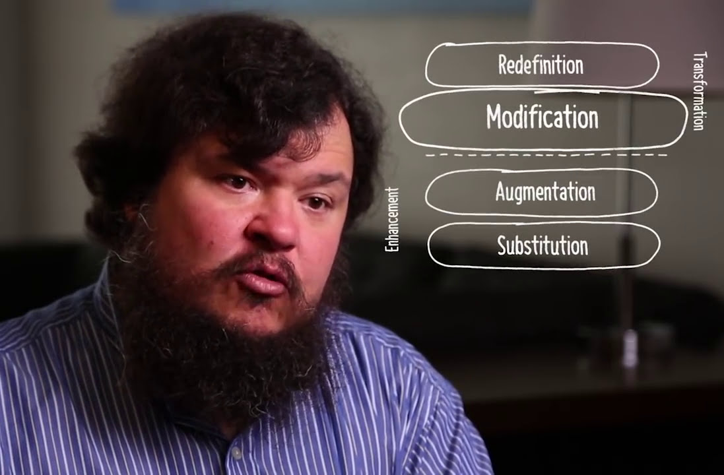
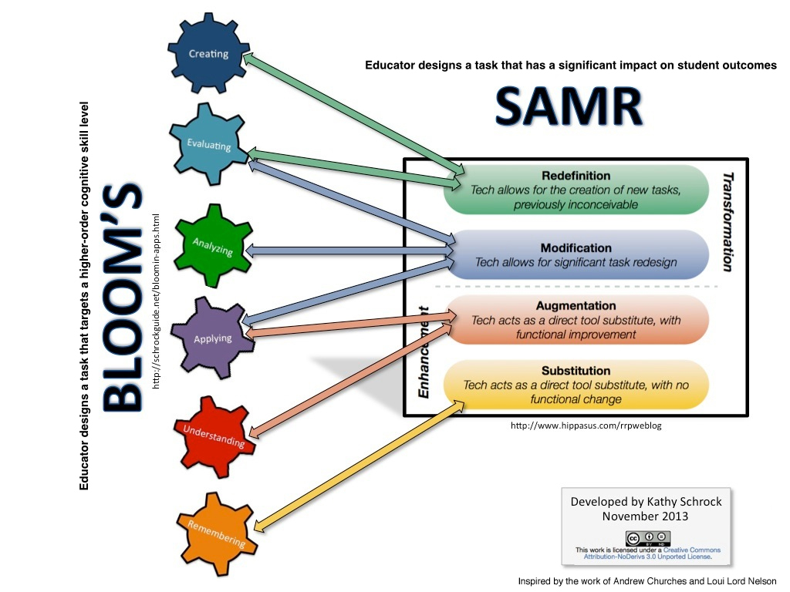
Development of the SAMR Model
Dr. Ruben Puentedura
https://i.ytimg.com/vi/ZQTx2UQQvbU/maxresdefault.jpg
https://upload.wikimedia.org/wikipedia/commons/5/53/SAMR-Bloom-Schrock.jpg

Slide 44
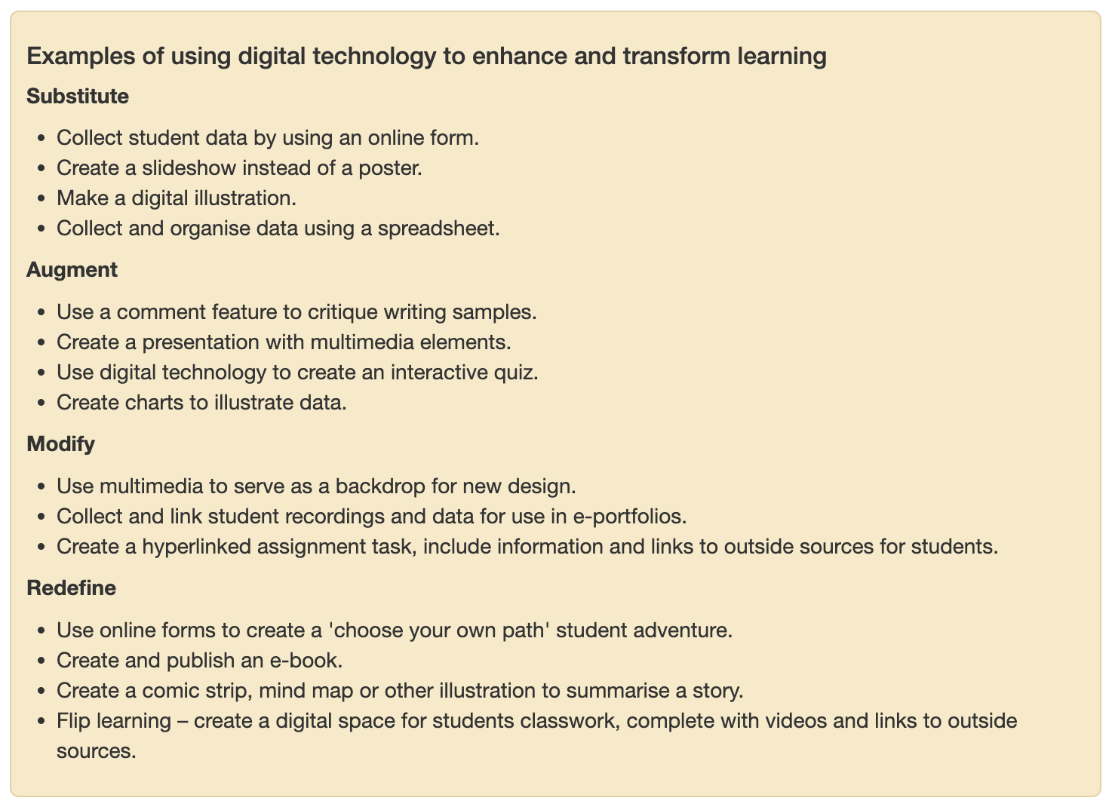
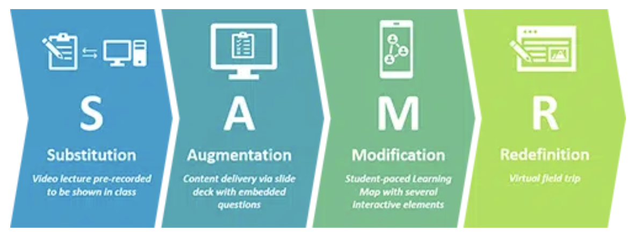
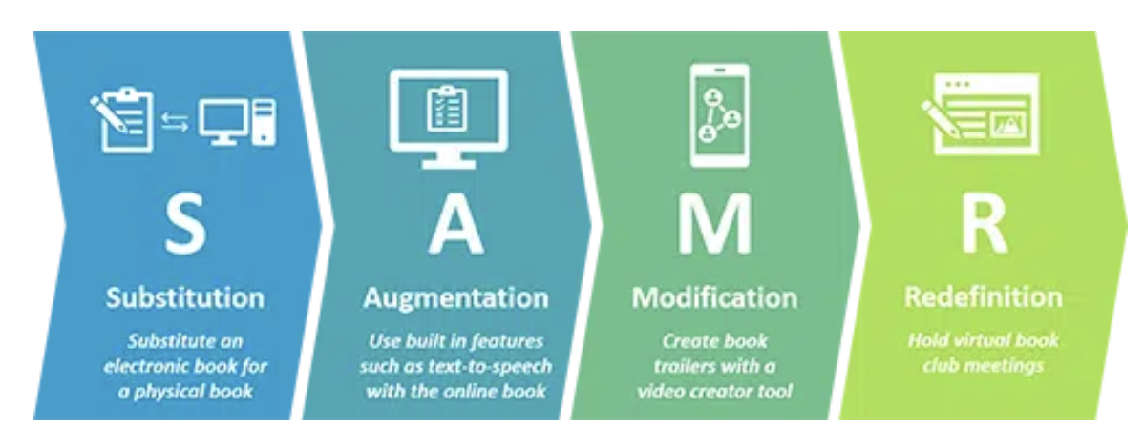
Enhancing and Transforming Learning
https://www.modelteaching.com/wp-content/uploads/2021/06/SAMR-Model-High-School-History.png.webp
https://elearning.tki.org.nz/Professional-learning/Teacher-inquiry/SAMR-model

Slide 45

The SAMR Model in Review
Using multimedia and technology can enhance and transform teaching and learning.
Using the SAMR model communicates to students that connections to learning can be made through multiple approaches.
SAMR along with Bloom’s Taxonomy, and TPACK afford a way to guide educators’ ability to construct an impactful use of technology for effective learning.
https://images.pexels.com/photos/4144224/pexels-photo-4144224.jpeg?auto=compress&cs=tinysrgb&w=1260&h=750&dpr=2

Slide 46
Conclusion
Connectivism
The Connectivism Learning Theory captures the needs of our 21st century demands, while emphasizing the effect that technology has on our society. Technological proficiency in our socially connected society allows a dynamic relationship to prosper while ensuring that we fulfill our education obligations.
Behaviorism Theory
Behaviorism reveal that every behavior is an outcome of external stimulus. Video, Robot and future application of VR technology in education will become the most effective external stimuli to transform students' learning response. And it will lead educational reform.
Cognitive-Affective Theory of Learning
with Media
Addresses cognitive load by introducing Multimedia to enhance motivation in learning, leading to less cognitive strain.
Constructivism in Multimedia Learning Environments
To enhance students’ engagement and increase retention of learning a series of best practices, theories, and educational models are implemented flipping traditional classroom environment through the TPACK Model and through Constructivism..

Slide 47
Conclusion
Animation
Animation can be used to promote learner understanding through the principles provided and by using Mayer's theory of multimedia learning.
SAMR
The SAMR Framework consisting of 4 levels, Substitution, Augmentation, Modification, and Redefinition, help educators enhance and transform teaching and learning with technology and media.
Adult Learning Theory
Adults learn differently from children, and are motivated to learn by the need to know, internal motivation, understanding the need for learning, using prior experience, self-direction, and aligning learning to reality.

Slide 48


Questions
Image obtained from: https://steadycompounding.com/life/how-to-ask-better-questions/
Image obtained from: https://www.skipprichard.com/ask-questions-to-improve-your-leadership/

Slide 49
Resources: Cognitive-Affective Theory of Learning with Media by Roxana Moreno
Moreno, R. (2007). Optimising learning from animations by minimising cognitive load: Cognitive and affective consequences of signalling and segmentation methods. Applied Cognitive Psychology, 21(6), 765-781. https://doi.org/10.1002/acp.1348
Moreno, R. (2009). Cognitive load theory: More food for thought. Instructional Science, 38(2), 135-141. https://doi.org/10.1007/s11251-009-9122-9
Moreno, R., & Durán, R. (2004). Do multiple representations need explanations? The role of verbal guidance and individual differences in multimedia mathematics learning. Journal of Educational Psychology, 96(3), 492-503. https://doi.org/10.1037/0022-0663.96.3.492
Moreno, R., & Flowerday, T. (2006). Students’ choice of animated pedagogical agents in science learning: A test of the similarity-attraction hypothesis on gender and ethnicity. Contemporary Educational Psychology, 31(2), 186-207. https://doi.org/10.1016/j.cedpsych.2005.05.002
Moreno, R., & Mayer, R. E. (2000). A coherence effect in multimedia learning: The case for minimizing irrelevant sounds in the design of multimedia instructional messages. Journal of Educational Psychology, 92(1), 117-125. https://doi.org/10.1037/0022-0663.92.1.117
Moreno, R., & Ortegano-Layne, L. (2007). Do classroom exemplars promote the application of principles in teacher education? A comparison of videos, animations, and narratives. Educational Technology Research and Development, 56(4), 449-465. https://doi.org/10.1007/s11423-006-9027-0

Slide 50
Resources: Animation as an aid to multimedia learning
Mayer, R. E., & Moreno, R. (2002). Animation as an aid to multimedia learning. Educational psychology review, 14(1), 87-99.

Slide 51
Resources: Constructivism and Multimedia Learning Environments
Adams, C. (2019). TPACK model: the ideal modern classroom. PB Pressbooks.
https://techandcurr2019.pressbooks.com/chapter/tpack-modern-classroom/.
Graham, G. (2008). Theory in Interactive Media Design, Journal of Humanities & Social Science. University of Texas
at Arlington. http://www.guillaumegronier.com/2020-psychologiegenerale/resources/Graham2008.pdf.
Hammond, T. C., & Manfra, M. M. (2009). Giving, prompting, making: Aligning technology and pedagogy within TPACK for social studies
instruction. Contemporary Issues in Technology and Teacher Education, 9(2), 160-185.
https://citejournal.org/volume-9/issue-2-09/social-studies/giving-prompting-making-aligning-technology-and-pedagogy-within-tpack-for-social-studies-instruction/
Harwood, C., & Mann, A. A Constructivist Approach to Teaching Media Studies Using Google Drive.
https://jitp.commons.gc.cuny.edu/a-constructivist-approach-to-teaching-media-studies-using-google-drive/.
MacKinnon, G. (2017). Highlighting the importance of context in the TPACK model: Three cases of non-traditional
settings. Issues and Trends in Educational Technology,
5(1).https://techandcurr2019.pressbooks.com/chapter/tpack-modern-classroom/.
Makewa, L. N. (2019). Constructivism theory in technology-based learning. In Technology-Supported Teaching and
Research Methods for Educators (pp. 268-287). IGI Global.
https://www.igi-global.com/chapter/constructivism-theory-in-technology-based-learning/213071.
Qiyun Wang (2009) Designing a web-based constructivist learning environment, Interactive Learning Environments,
17:1, 1-13, DOI: 10.1080/10494820701424577.

Slide 52
Resources: Substitution, Augmentation, Modification, and Redefinition (SAMR) Model
Incorporating technology into the classroom - the SAMR model. Model Teaching. (2021, October 14). Retrieved April 1, 2022, from https://www.modelteaching.com/education-articles/technology-in-the-classroom/incorporating-technology-into-the-classroom-using-the-samr-model
Incorporating technology into the classroom - the SAMR model. Model Teaching. (2021, October 14). Retrieved April 4, 2022, from https://www.modelteaching.com/education-articles/technology-in-the-classroom/incorporating-technology-into-the-classroom-using-the-samr-model
Lefflerd. (2016). Explanation of the Samr Model. Wikimedia Commons. Retrieved April 4, 2022, from https://upload.wikimedia.org/wikipedia/commons/5/5e/The_SAMR_Model.jpg.

Slide 53
Resources: Connectivism Learning Theory
Dunaway, M. K. (2011). Connectivism: Learning theory and pedagogical practice for networked information landscapes. In Reference Services Review (Vol. 39, Issue 4, pp. 675–685). https://doi.org/10.1108/00907321111186686
Kivunja, C. (2014). Do You Want Your Students to Be Job-Ready with 21st Century Skills? Change Pedagogies: A Pedagogical Paradigm Shift from Vygotskyian Social Constructivism to Critical Thinking, Problem Solving and Siemens’ Digital Connectivism. International Journal of Higher Education, 3(3). https://doi.org/10.5430/ijhe.v3n3p81
Korhonen, A., & Multisilta, J. (2017). Learning analytics. In New Ways to Teach and Learn in China and Finland: Crossing Boundaries with Technology (pp. 301–310). Peter Lang AG. https://doi.org/10.1177/0002764213498851
Siemens, G. (2005). Connectivism: A learning theory for the digital age. International Journal of Instructional Technology and Distance Learning, 2(1). Retrieved from http://www.itdl.org/

Slide 54
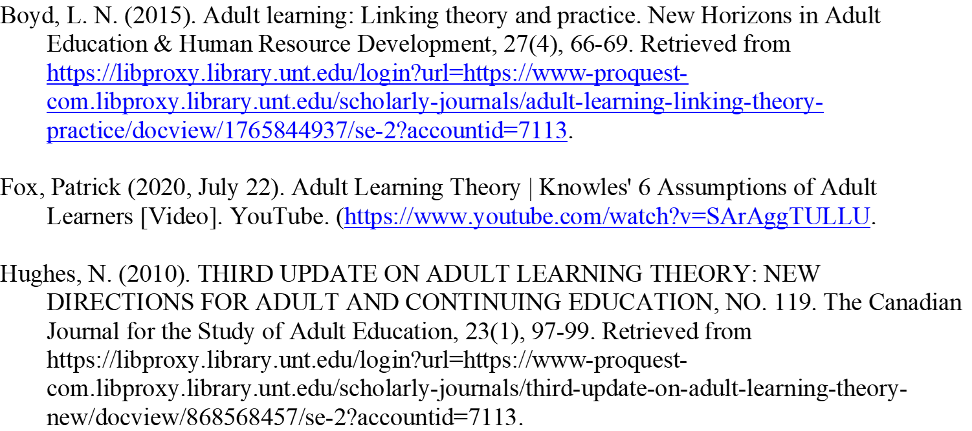
Resources: Adult Learning Theory

Slide 55
Resources: Behaviorism Theory in Multimedia learning
Barell, J. (2010). Problem-based learning: The foundation for 21st century skills. In J. Bellanca & R. Brandt (Eds.), 21st Century Skills (pp. 174-199). Bloomington, IN: Solution Tree Press.
Ertmer, P. A., & Newby, T. J. (1993). Behaviorism, cognitivism, constructivism: Comparing critical features from an instructional design perspective. Performance Improvement Quarterly, 6(4), 50-72.
Kay, K. (2010). 21st Century skills: Why they matter, what they are, and how we get there. In J. Bellanca & R. Brandt (Eds.), 21st Century Skills (pp. xii-xxxi). Bloomington, IN: Solution Tree Press.
Mayer, R. E. (2009). Multimedia learning (2nd ed.). Cambridge, UK: Cambridge University Press.
Prensky, M. (2010). Teaching digital natives: Partnering for real learning. Thousand Oaks, CA: Corwin.

Slide 56
Attribution
Please keep this slide for attribution.

