Slide 1

Keeping Kids Safe in the Digital Age
"Distrust and caution are the parents of security" - Benjamin Franklin

Slide 2
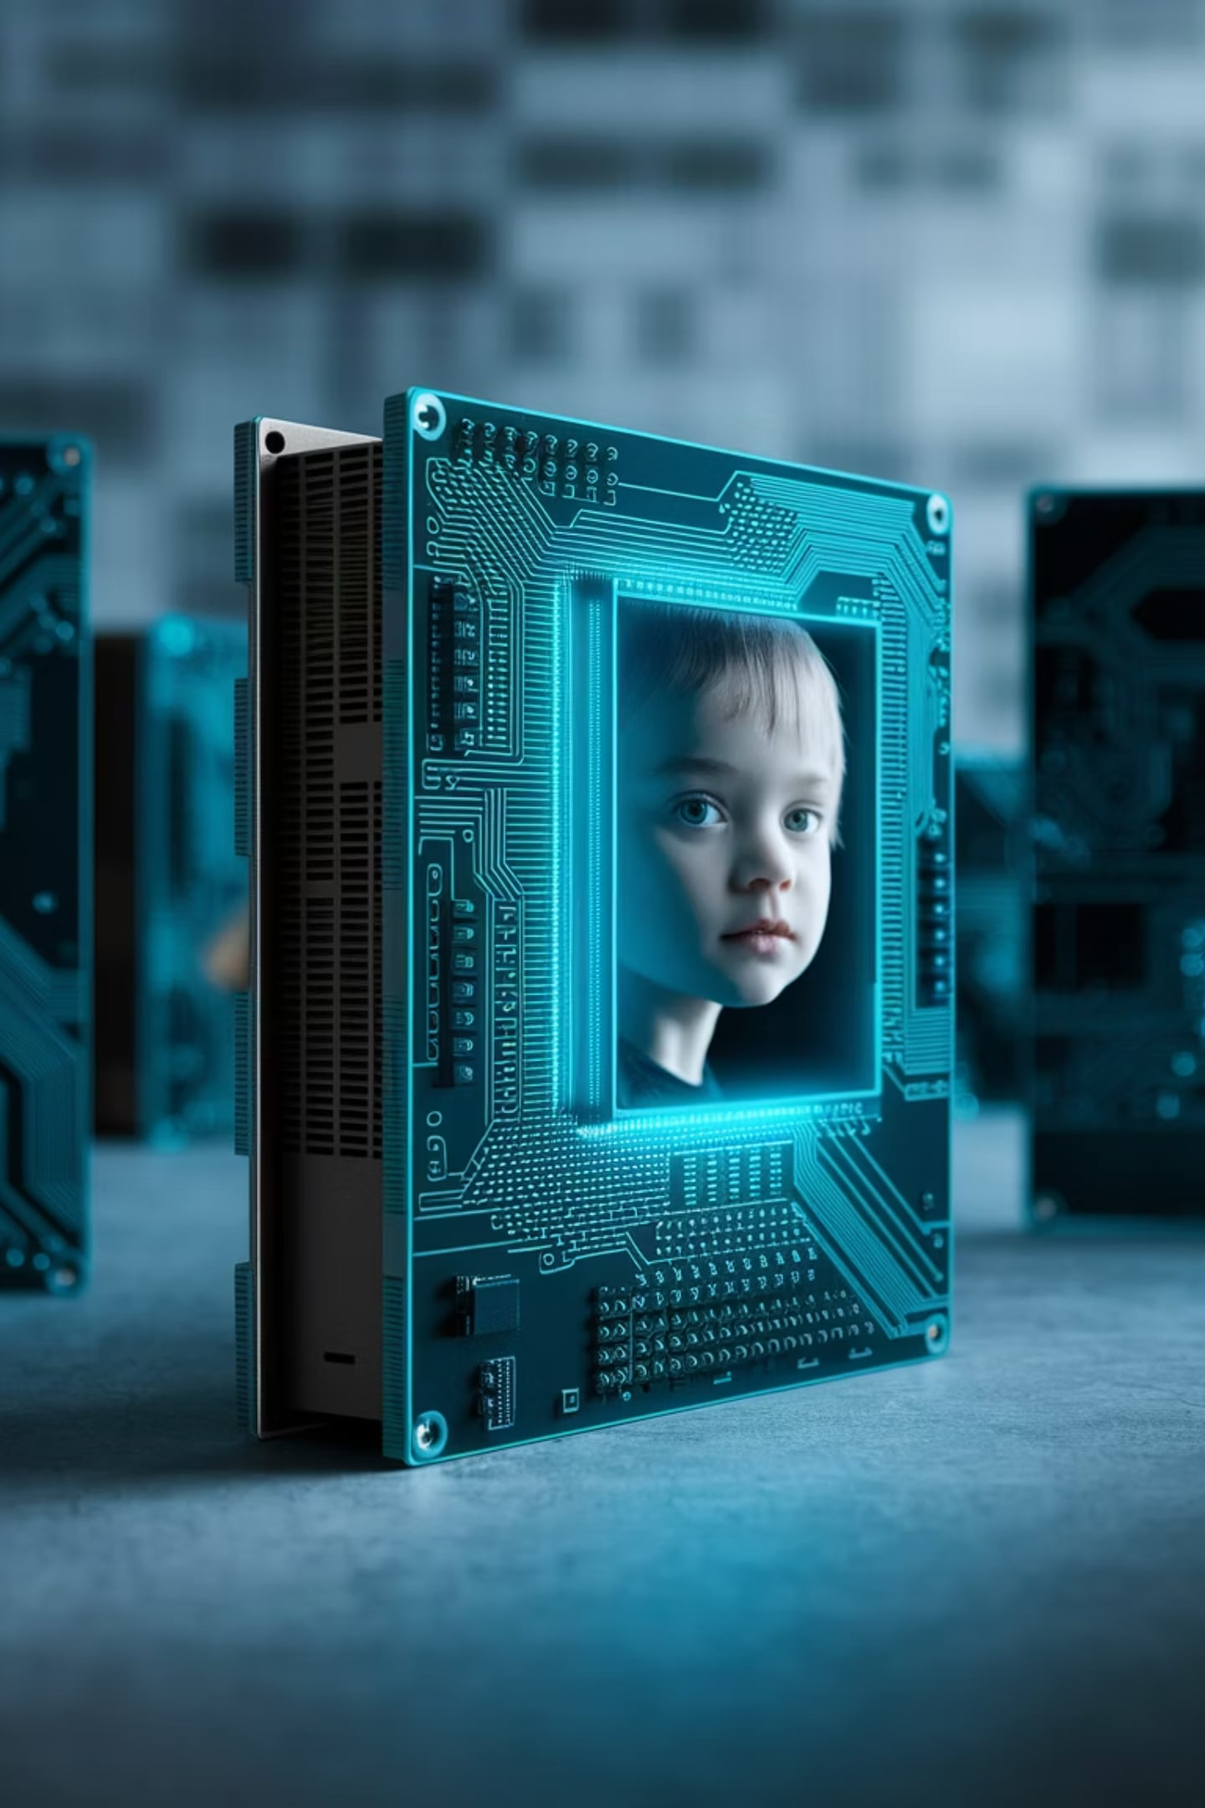
Agenda
1
Misinformation and Its Consequences
Explore the dangers of false information.
2
Data Collection and Privacy
Understand the importance of protecting personal data.
3
AI and Transparency
Learn about creating open, accountable AI systems.
4
AI as a "Guarding Angel"
Discover how AI can act as a responsible tutor.

Slide 3
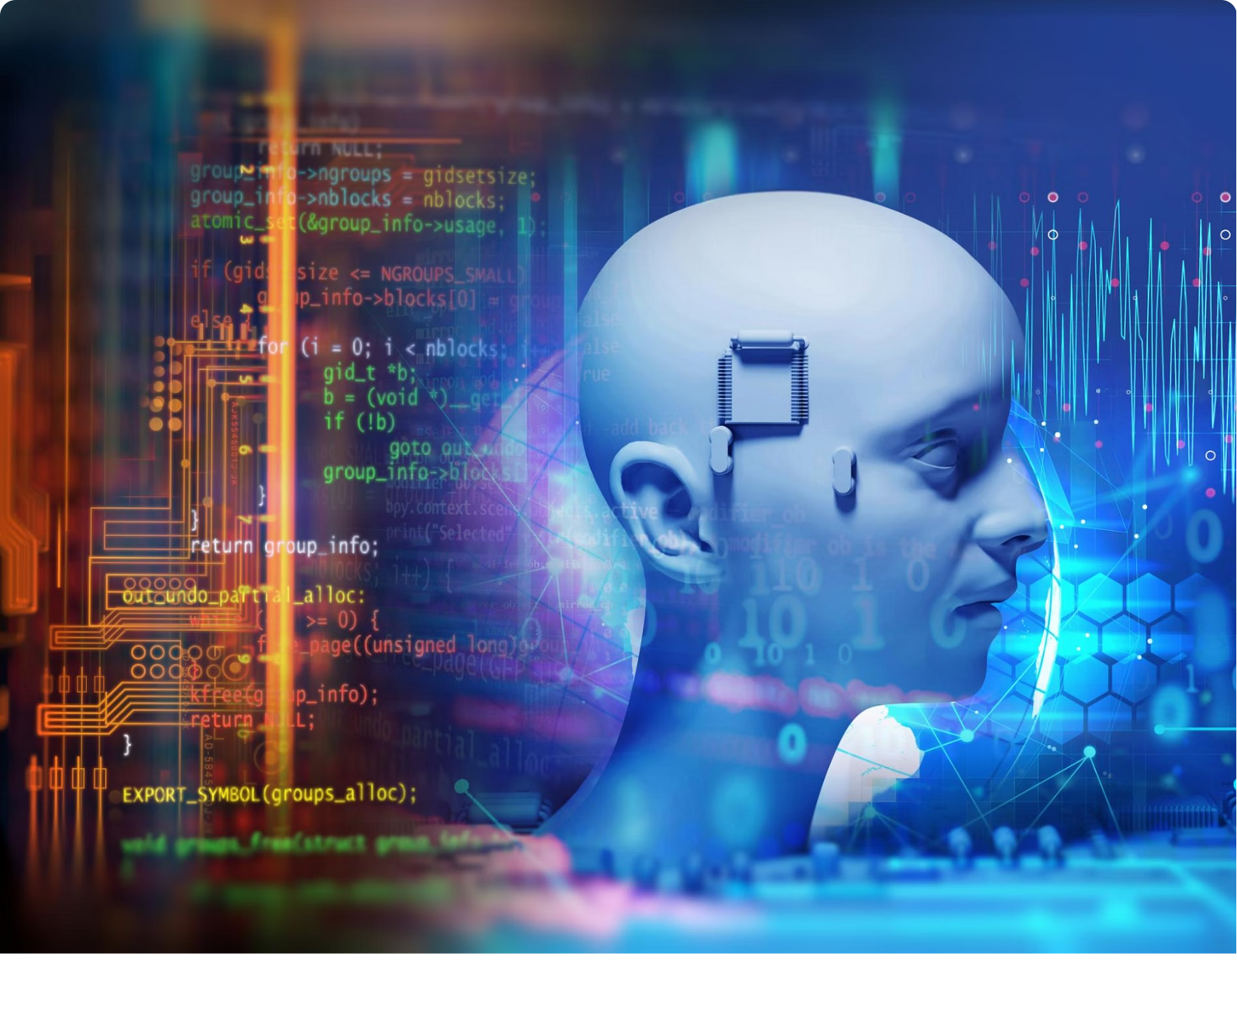
Role of Gen-AI in Creating Information
Historical Context of AI
Not something new as AI used algorithms to attract attention to ads and click bait.
Past 15 years, mental health in youth has declined by “most measures”
  Baylor Researchers Explore Effect of Instagram, TikTok on Psychological Well-Being
  Teens and social media use: What's the impact?
We can train AI to review skills on merit whereas before the human mind was subjective in its choices.
AI keeps improving (GPT 4 is better than GPT 3).

Slide 4

Impact of Misinformation on Children
Consequences
1
Misinformation affects young minds.
2
Search Engine Optimization (SEO) Exploitation
Fear is used for profit via SEO.
Reinforced Bias
3
Existing biases improve ratings.

Slide 5

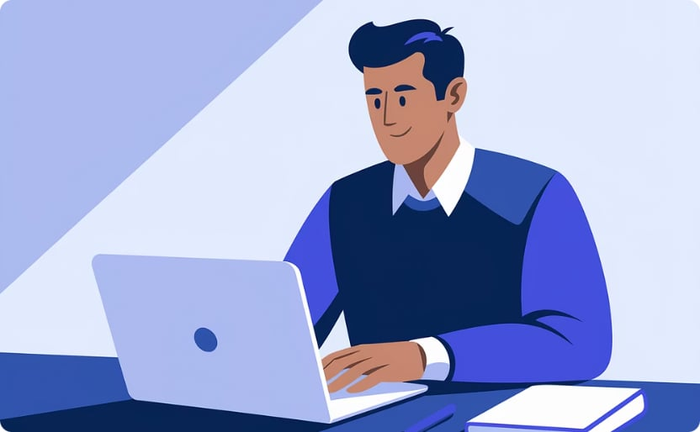


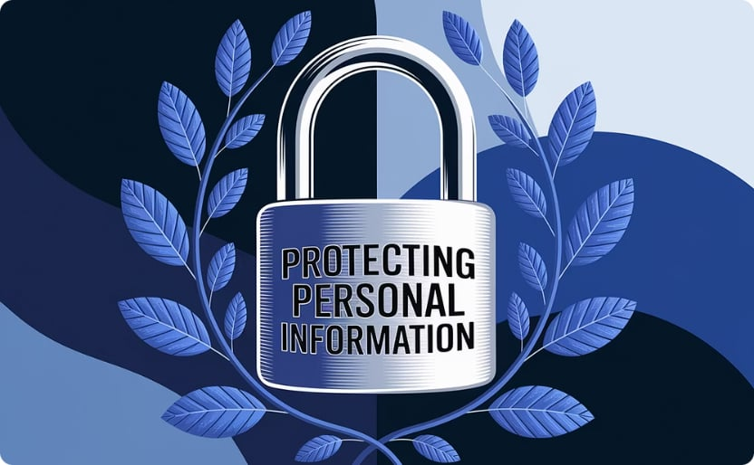
Training AI
AI Skill Review
Gen AI Guardrails
Jailbreak Prompts
AI reviews skills based on merit.
Built to prevent misinformation.
Methods to manipulate LLMs exist.
Data Protection Tips
Set Standards
Assess Apps
Ensure Security
Protect Information
Uphold high data protection standards.
Be cautious with applications intended for children.
Implement sensible security measures.
Safeguard personal information diligently.

Slide 6





AI Tutor as a Browser Plug-In
AI Tutor
Reformulating Information
Helps children browse educational sites.
Adjusts content to child's grade.
Socratic Engagement
Ethical Guidance
Encourages engagement and context.
Functions like a real tutor reviewing sites.

Slide 7


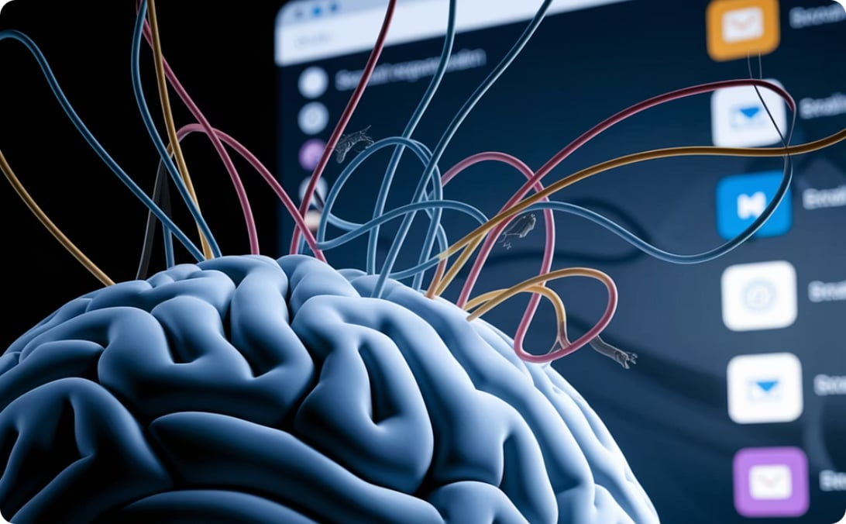
AI Agents for Internet Safety
Refocusing Usage
Exposure
Negative Impacts
Provides information on time spent online. Assists in managing activities.
Vast information and services are provided online.
Content affects mental health.

Slide 8
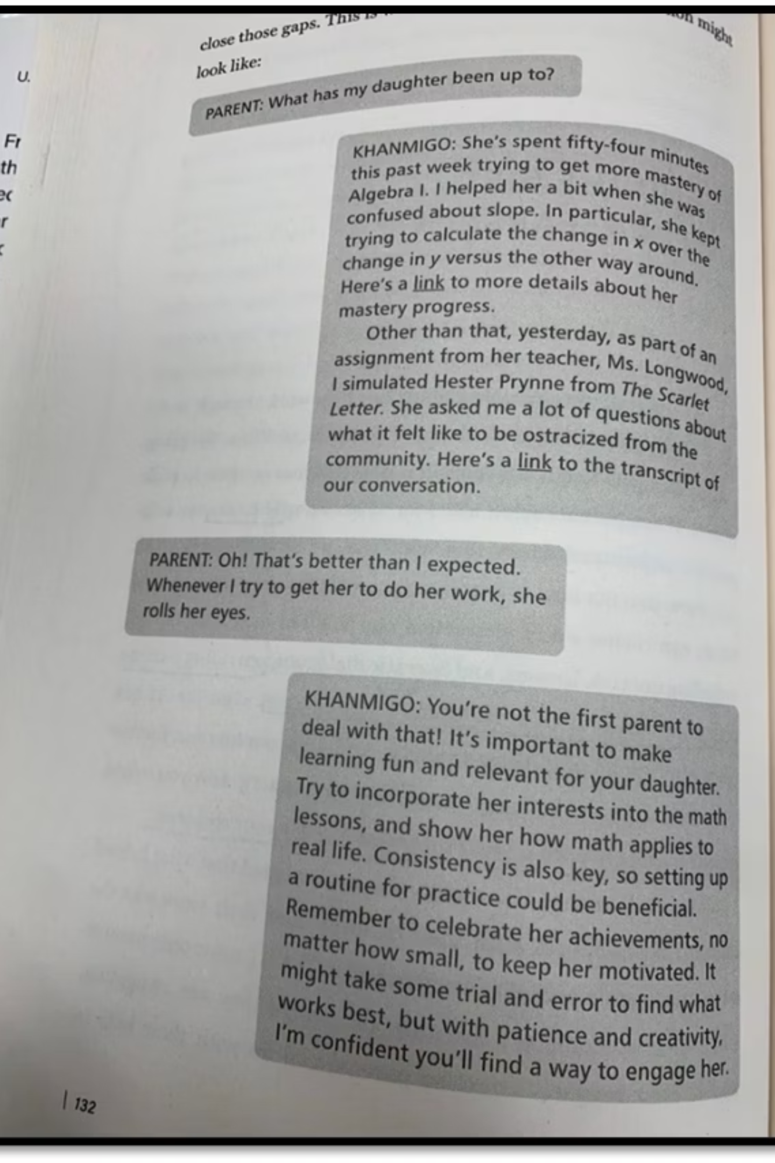
Screenshot of Interaction

