Slide 1
Interdisciplinary Team Science:
Perception of First-Year Ph.D. Students
Notes:
J-BO 1 of 4
Janetta → Introduce 4 authors, Intro, Lit Review
Lance → Methods
Bau → Results and Discussion
Erin → Conclusion, thank them for attending, highlight the contact info

Slide 2

Janetta Boone
Lance Whisenant
Bau Tran
Erin Howard
Notes:
J-BO 2 of 4

Slide 3
INTRO & LIT REVIEW
1
Q1 Do students understand the importance of team science in the future of work?
Q2 What potential team science curricula might benefit graduate and doctoral level students?
Notes:
J-BO 3 of 4

Slide 4
As team science trends upwards due to a global, remotely connected workforce, the relatively small number of relevant articles serves to magnify the growing nature and importance of interdisciplinary team science.
Notes:
J-BO 4 of 4

Slide 5
METHODS
Participants
1st-year Ph.D. LTEC students (UNT).
Materials
27-question survey (Likert, Dichotomous, Open-ended).
Procedures
Survey via email (7-16-21 through 7-26-21)
Notes:
Bau 1 of 2
Participants
To understand students' perception of interdisciplinary team science at the University of North Texas, we set to sample first-year Doctor of Philosophy (Ph.D.) students from the Learning Technologies cohorts of 2024 and 2025 due to the wide-ranging nature of individual doctoral study topics, representing interdisciplinary team science. All respondents consented to participate in the study.
Materials
This mixed-method research collected data from a 27-question survey utilizing a combination of primary 5-point Likert scale participant survey questions (strongly agree, agree, neither agree nor disagree, disagree, and strongly disagree), five dichotomous survey questions (yes/no), and six open-ended questions were included to allow participants to elaborate on their answers.
Procedures
The study was conducted at a single center here at the University of North Texas and was approved by the University IRB to conduct this research project. The survey was distributed to study subjects via email and asked to participate in the study from July 16, 2021, to July 26, 2021, from the Learning Technologies Ph.D. Program. We provided them a direct link to the survey and a single reminder email sent to maximize the overall response rate. Upon accessing the provided link, informed consent was obtained, allowing the participant to proceed to the survey. We preserved respondents anonymity. Data was collected and maintained by Qualtrics, a secure web application.

Slide 6
RESULTS
From July 16, 2021, to July 26, 2021, the survey was distributed to all Ph.D. students from the Learning Technologies Program at the University of North Texas with 28 participants in total.
Notes:
BAU 2 of 2
Data was gathered from July 16 thru the 26th and we had 28 participants total.
We took that data and analyzed to gauge
attitudes and knowledge level of first-year Ph.D. students pertaining to interdisciplinary team science
as well as understanding
the importance of team science in future works
the potential benefit of team science curricula at the graduate and doctoral level.
We compared the mean number of participants in each described category for both cohorts.
Descriptive statistics (mean, percentage) was used to characterize the scores for each Likert question and qualitative responses were manually coded amongst the researchers.

Slide 7
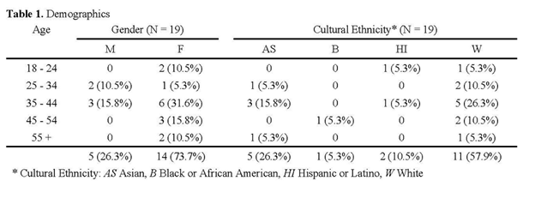
DEMOGRAPHICS
Notes:
LANCE 1 of 3
Of the 28 respondents, only 19 (67.9%) respondents qualified for this study (1st year Ph.D. student) with the majority of research participants were white (57.9%), female (73.7%), and 35 – 44 years of age (47.4%) (Table 1).

Slide 8
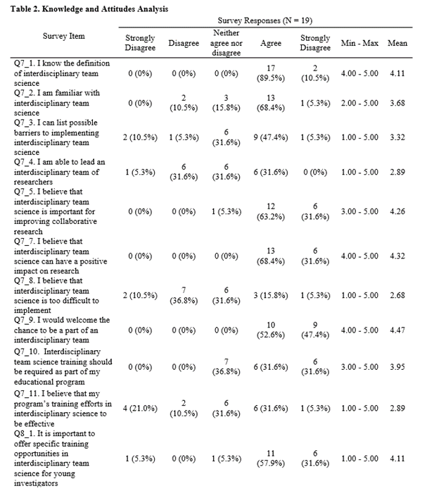
KNOWLEDGE & ATTITUDES ANALYSIS
Notes:
LANCE 2 of 3
The results are categorized into three domains: knowledge and attitudes, content and training, and educational opportunities.
The domain of knowledge and attitudes was ranked on a 5-point Likert scale. In contrast, the domains content/training and educational opportunities collected qualitative data utilizing open-ended questions.
Survey results indicated that 68.4% of students agreed that interdisciplinary team science can have a positive impact on research, additionally, 52.6% agreed and 47.4% strongly agreed that they would welcome the chance to be part of an interdisciplinary team. Interestingly, when asked if they were able to lead an interdisciplinary team of researchers, 31.6% of respondents indicated they disagreed with the statement, and 47.4% indicated that they could list possible barriers to implementing interdisciplinary team science. Furthermore, we found that when asked if it was important to offer training opportunities for young investigators, one respondent (5.3%) stated that they strongly disagreed with the statement. We followed up this question by asking the respondents to explain their responses and found that the words “student(s),” “team(s),” and various forms of the word “collaborate” were mentioned eight, six, and five times.
Question nine of the survey focused on the amount of training the respondents have received regarding interdisciplinary team science. Survey results revealed that 50% of the students surveyed were unsure if their institution offered specific training in interdisciplinary team science as part of their educational portfolio. The survey followed up by asking the student if they were enrolled or planned to enroll in specific training for interdisciplinary team science, and 11 respondents (61.1%) stated “No”. Of the seven (38.9%) respondents who stated yes, 57.14% described their course content as a case-based course in which students reviewed case studies in interdisciplinary team science and developed strategies for pursuing interdisciplinary team science opportunities despite obstacles. However, despite many of the students stating they were not currently, nor did they plan to enroll in specific training for interdisciplinary team science, we found words such as “fascinated/interested”, and “important/benefit” were mentioned three and two times respectively when asked to explain their response, which was a direct contradiction.

Slide 9
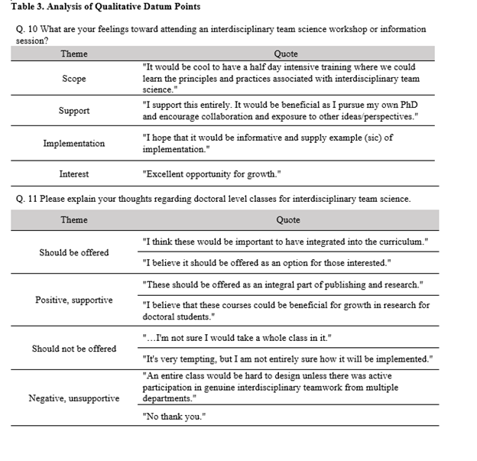
ANALYSIS OF QUALITATIVE DATUM POINTS
Notes:
LANCE 3 of 3
Questions 10 and 11 were open-ended asking participants the following questions: (1) What are your feelings towards attending an interdisciplinary team science workshop or information session? and (2) please explain your thoughts regarding doctoral-level classes for interdisciplinary team science. The datum points analyzed from the instrument are summarized in Table 3.
Highlight interesting.

Slide 10

DISCUSSION
The results from the survey indicate that students can define interdisciplinary team science and are largely familiar with the topic.
However, students in the study also indicated that they could list barriers related to implementation and that it could prove too difficult to execute.
One respondent stated that they were “not aware of a training related to interdisciplinary team science but if there were one, I would enroll”, with another stating they had “no time to take on non-mandatory coursework.”
Interestingly, one student stated that “it’s very tempting but I am not entirely sure how it will be implemented”, with another suggesting that “such courses should be optional or offered in a condensed timeline (e.g., a maymester or a 3-week module). I’m not sure I would take a whole class in it.”
Notes:
ERIN 1 of 3

Slide 11
CONCLUSION
Training
Multifactorial
Limitation
Notes:
ERIN 2 of 3

Slide 12



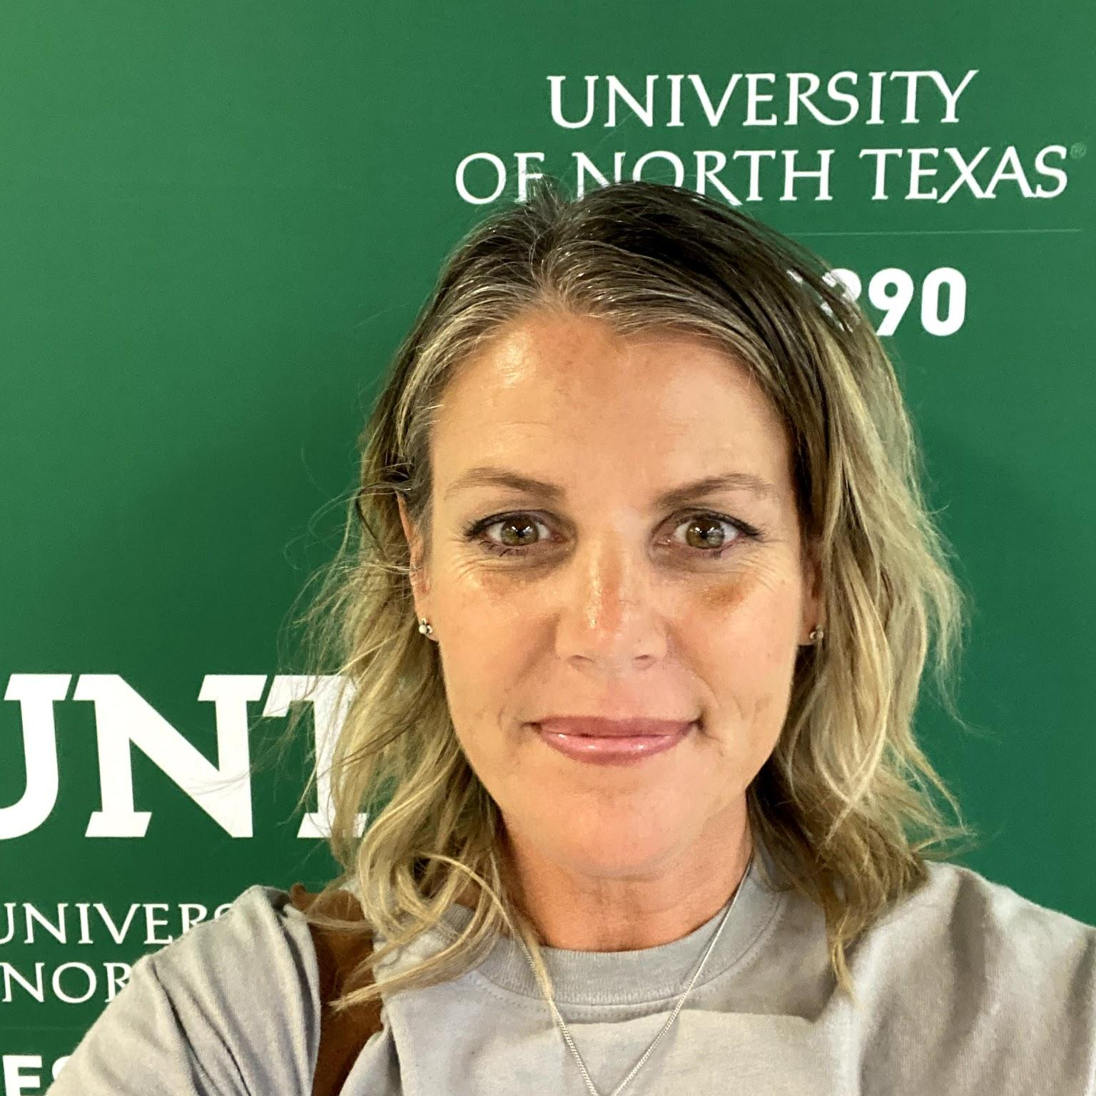
Author Contact Information
Janetta Robins Boone
janettarobinsboone@my.unt.edu
Lance Whisenant
lancewhisenant@my.unt.edu
Bau Tran
bautran@my.unt.edu
Erin Howard
erinhoward2@my.unt.edu
Notes:
ERIN 3 of 3
All, please right click on the stock portrait and click → replace image to add your professional headshot

