Slide 1

Agency-Wide Information Technology Plan
Modernization of Texarkana college

Slide 2
Introduction
H.B 4018
Modern, secure, and technologically robust environment
Agency objectives, value statement, goals, and key business functions
Modernization plan for major initiatives

Slide 3
Background Information
The increasing need to transmit information across networks of computers renders data more vulnerable to accidental or deliberate unauthorized modification or disclosure.
To maintain the confidentiality, integrity, and availability of our data or systems, we created five initiatives that will allow our institution to operate in the digital environment safely and effectively.
These initiatives ensure that TC information is protected against unauthorized access through means of technical and manual controls while preserving the integrity of said information through tools, techniques, and processes which provide adequate assurance that systems are free from unauthorized manipulation.
According to Liu et al. (2020), “there has been increasing awareness of the importance of information security among researchers and practitioners” (p. 4).
Our aim in creating a modern IT network is to ensure our institution’s place as a safe, efficient, and threat resistant atmosphere for our faculty, staff, and students. To do so, it is imperative that our administration is tasked with funding and approving the products needed to enhance our digital atmosphere, understand the core concepts of security, and can explain why we must safeguard all our systems when moving forward

Slide 4
Purpose, Objective, and Goals
Our highest priority is increasing the number of people with higher education credentials in our area, while staying committed to our student success and completion rates.
Our common goal is to assist our community by striving for 60 percent of the 25–34-year-old Texas population to hold a certificate or degree by 2030.
  TC will increase fall enrollment for technical programs and annual contact hours for continuing education courses by 20% by end of the 2024 academic year compared to fall 2021.
  TC will develop a financial stability plan in response to the current economic environment and will continue advocacy at the state level for increased support.
  By fall 2023, the TC primary instructional format for academic courses will be in 8-week terms.
  TC will employ highly qualified faculty and staff to better reflect the community and campus demographics.
  The TC Foundation will reach $15 million in assets by 2025. TC will investigate other credit and non-credit health care programs to produce entry level workers.

Slide 5
Modernization Initiatives
New Data Center
Enhanced Communication
OneDrive & SharePoint
Modern Authentication
Jenzabar Financial Aid

Slide 6
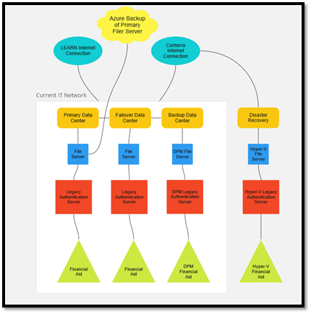
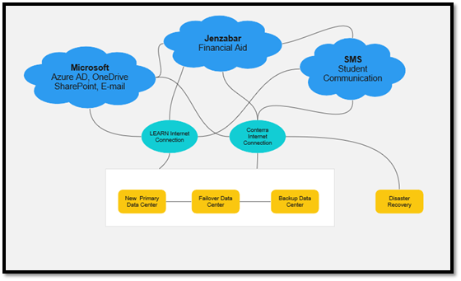
Critical Information Technology Roadmap
Current IT Network
MODERN IT NETWORK

Slide 7
Evaluation
As we phase out legacy authentication protocols within our network, our IT department will be better positioned to audit logins through Azure AD and make operational decisions via localized console.
Our methodology consists of applying our changes in a test environment prior to implementing them in any production atmosphere. In doing so, we monitor for potential bugs, crashes, and/or other types of system failures that may cause a disruption to our production network.
Our Senior System Administrator is tasked with migrating each department to Microsoft SharePoint and in determining the timeframe for the migration.
We will establish a schedule where each department will receive training on how to access and ensure their data is secured in our cloud environment and on the elimination of prior legacy methods that were established as a temporary solution (namely, our shared drives feature).

Slide 8
Evaluation (cont.)
Penetration Testing
AT&T Cybersecurity will conduct a security program maturity assessment following control objectives based on the Texas Cybersecurity Framework (TCF) and the Department of Information Resources (DIR) Security Control Standards Catalog.
The TCF consists of forty-two (42) security objectives within the following five (5) functional areas: Identify, Protect, Detect, Respond, and Recover. These TCF Assessments evaluate the maturity level of each security objective and provide recommendations for improving the security maturity and posture of the organization.
Penetration Testing (cont.)
With this information in mind, AT&T will conduct their testing as part of our evaluation plan in measuring cloud security controls. Additionally, AT&T Cybersecurity will provide strategic recommendations to help us address and manage cybersecurity risk in a cost-effective way that is based on business needs.

Slide 9
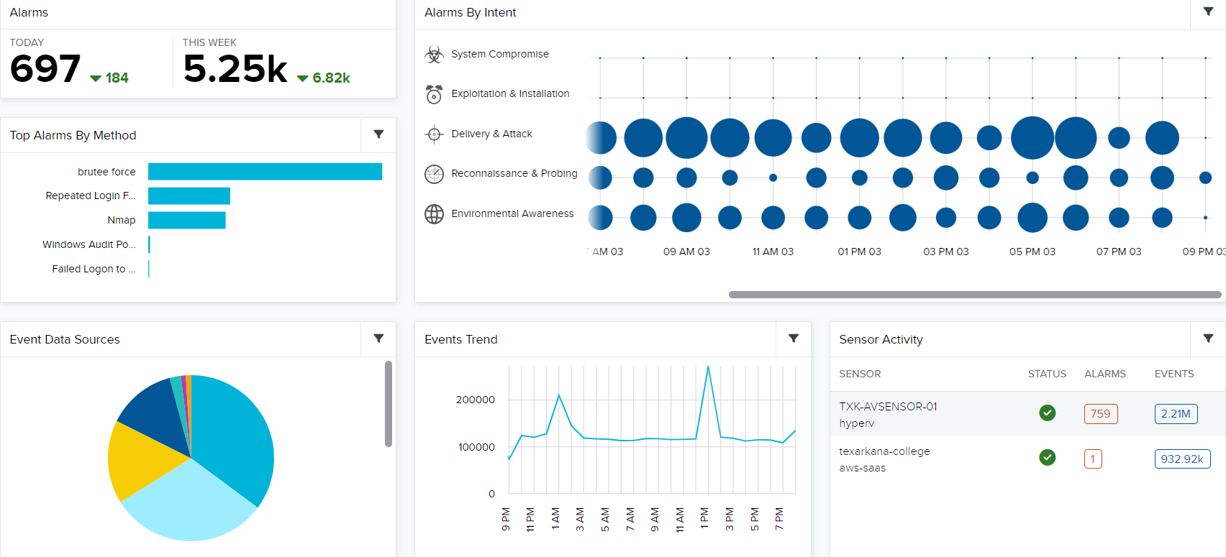
Pen Testing in Action

Slide 10
Conclusion
We believe the changes we are implementing will provide a more secure environment for our institution’s data as well as provide a more stable foundation for our DR plan.
In modernizing our network, we further provide an alliance with our strategic objectives and enhance the students’ experience by providing a redundant Internet connection and cloud security.
The End

